Slide 1

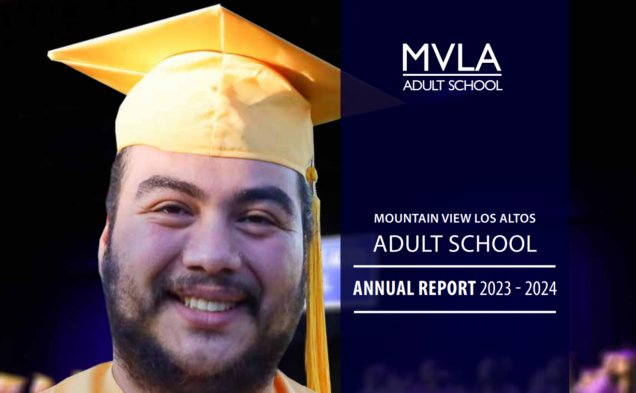
Presented by
MVLA Adult School Leadership Team
March 3, 2025
Notes:
Welcome/Intro -Julie

Slide 2


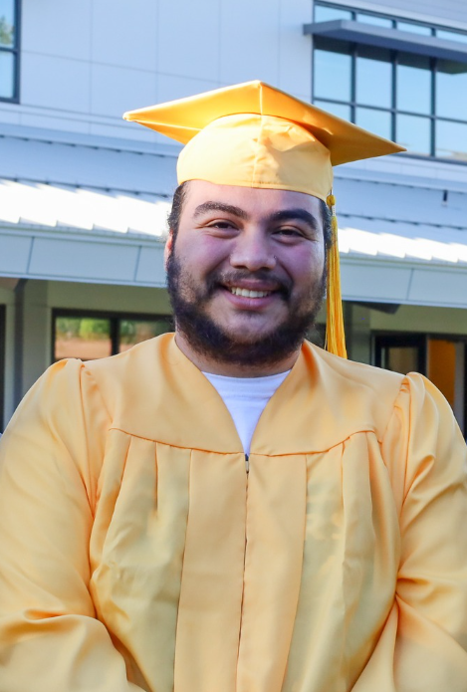
Agenda
MVLA Adult School Overview
WASC Schoolwide Goals
Student Performance Data and Current Progress & Priorities by Program
Student Support Services
Student Success Stories
Fiscal Solvency
Looking Ahead
Notes:
Julie

Slide 3

MVLA Adult School Mission Statement
MVLA Adult School is committed to engaging, supporting, and empowering all adult learners from diverse backgrounds. Students will gain the knowledge, proficiency, and technical skills necessary to succeed in employment, secondary education, and community integration.
Student Learning Outcomes
Students will:
  Set goals and progress towards them
  Achieve a measurable increase in knowledge, skills and proficiency in their goal area
  Be able to apply knowledge, skills and proficiency to employment and continuing education
Notes:
Julie

Slide 4
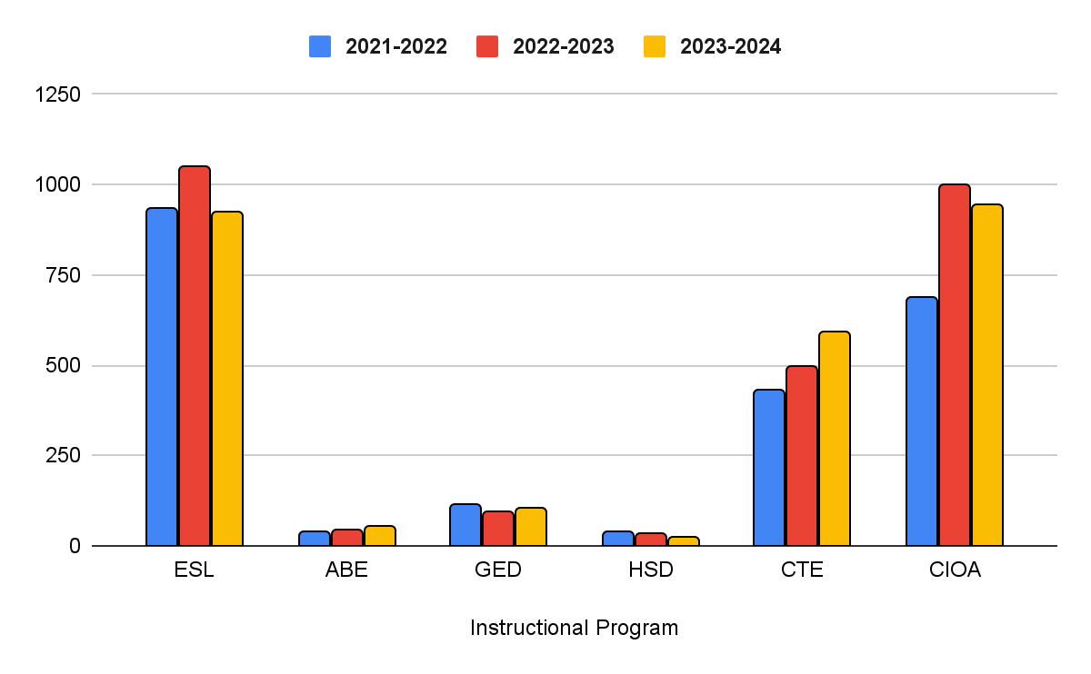
MVLA Adult School Programs
Enrollment Trends (Unduplicated)
Overall duplicated enrollment for 2023-2024 was 5189. Unduplicated enrollment by Adult Education Programs from 2022-2023 to 2023-2024 showed a decrease of nearly 12% in ESL due to changing demographic/proficiency level of students. There was a slight increase in ABE and GED enrollments, and a slight decrease in HSD enrollment. CTE enrollments increased by over 19%. Non-academic / fee-based programs enrollment decreased by 5%.
Notes:
Julie

Slide 5
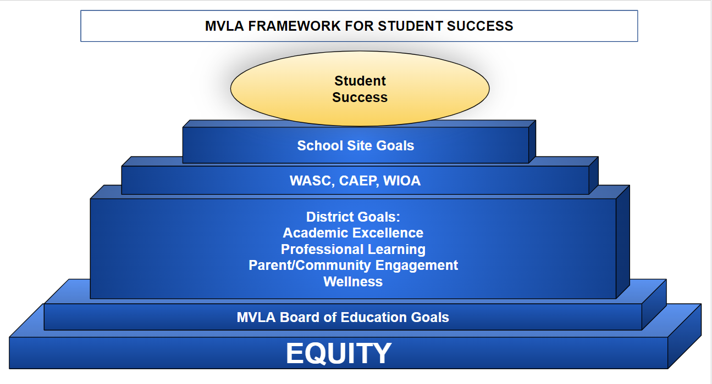
2024-2025 Guiding Principles
Notes:
Julie

Slide 6
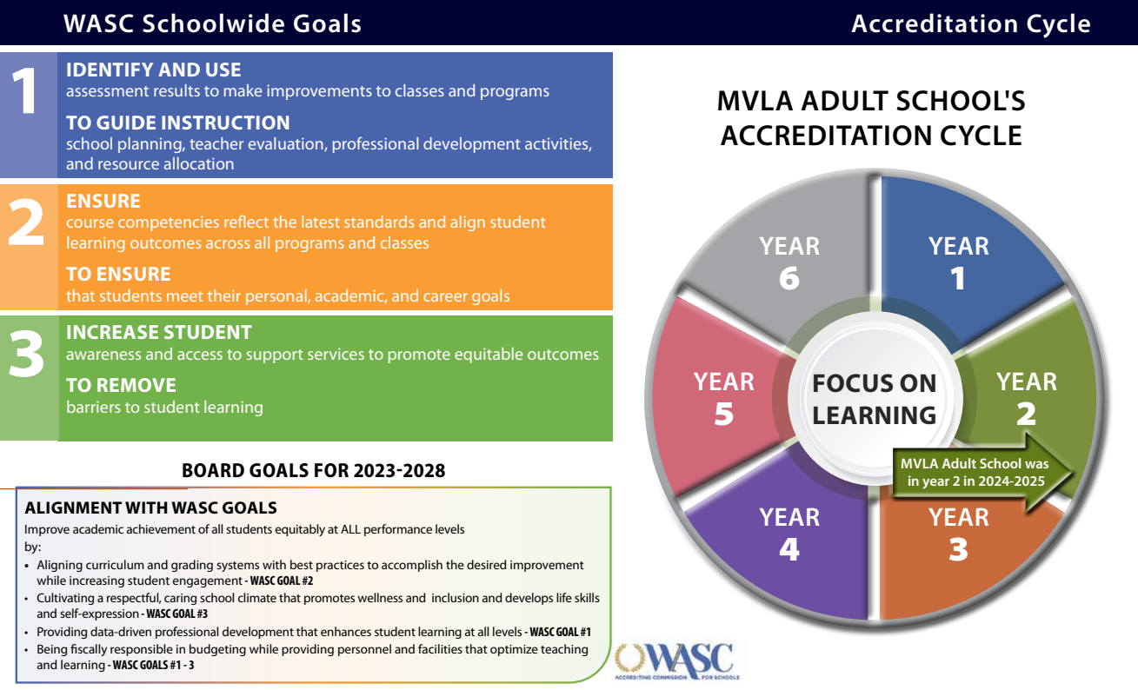
Notes:
Julie

Slide 7



MVLA Adult School
WASC Schoolwide Goals
Identify and use assessment results to make improvements to classes and programs
Ensure course competencies reflect the latest standards and align student learning outcomes across all programs and classes
Increase student awareness and access to support services to promote equitable outcomes
To guide instruction, school planning, teacher evaluation, professional development activities, and resource allocation
To ensure that students meet their personal, academic, and career goals
To remove barriers to student learning
Notes:
Jonathan

Slide 8
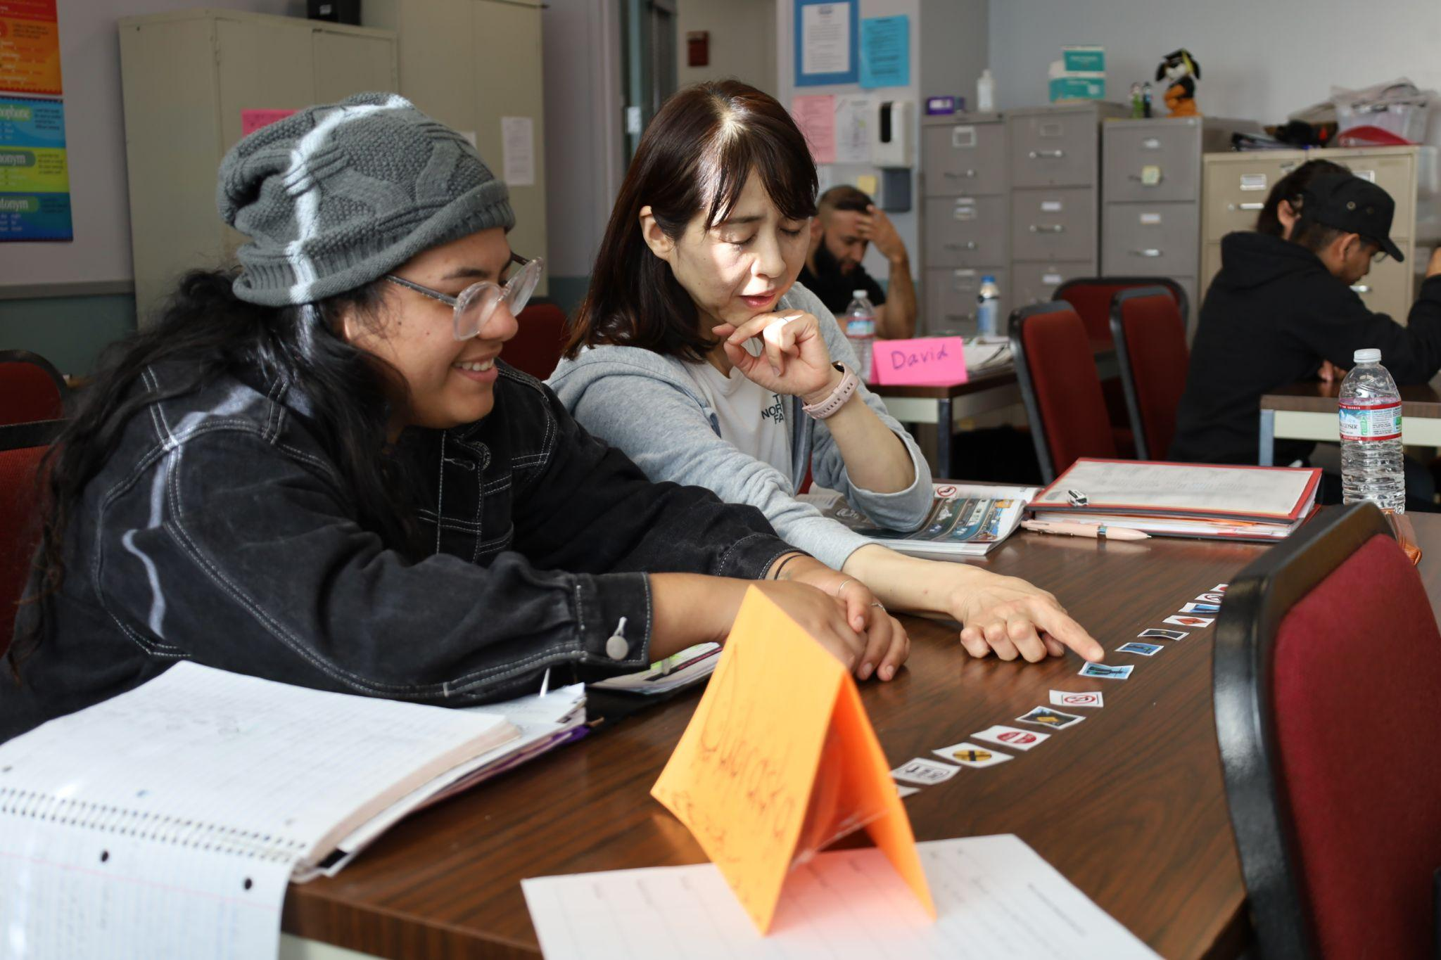
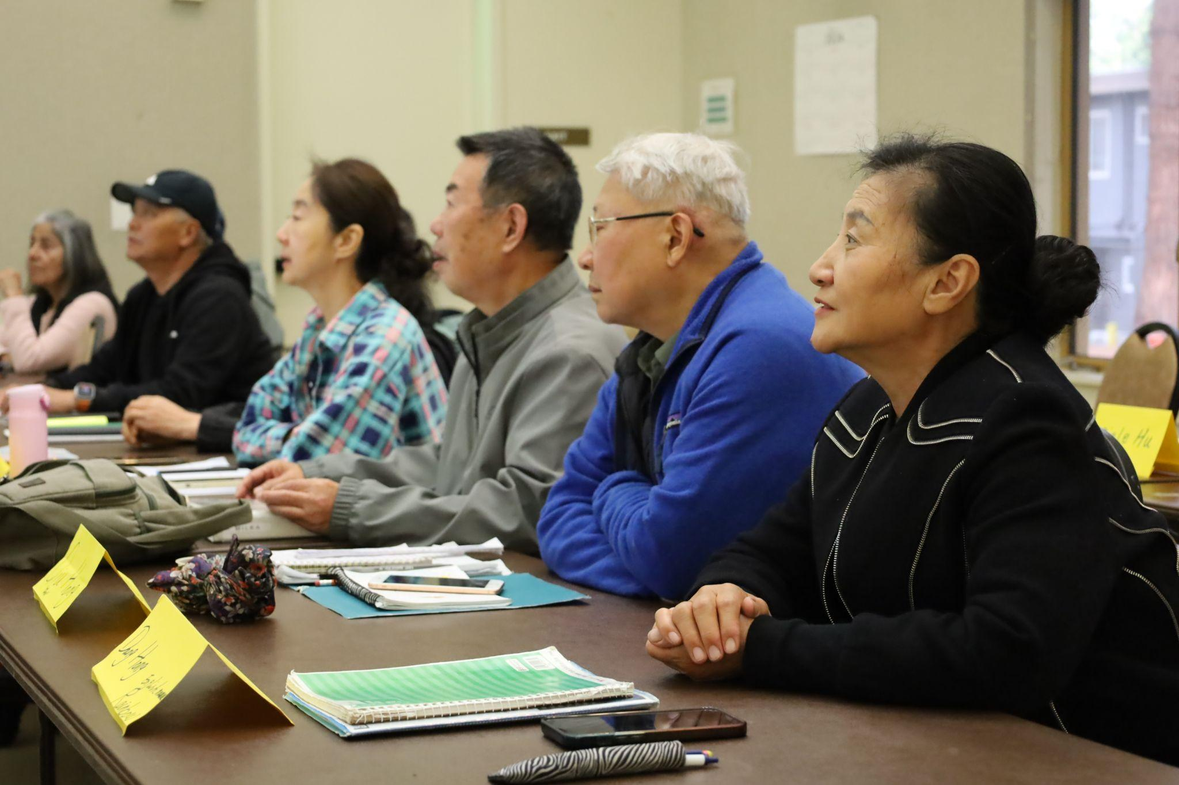
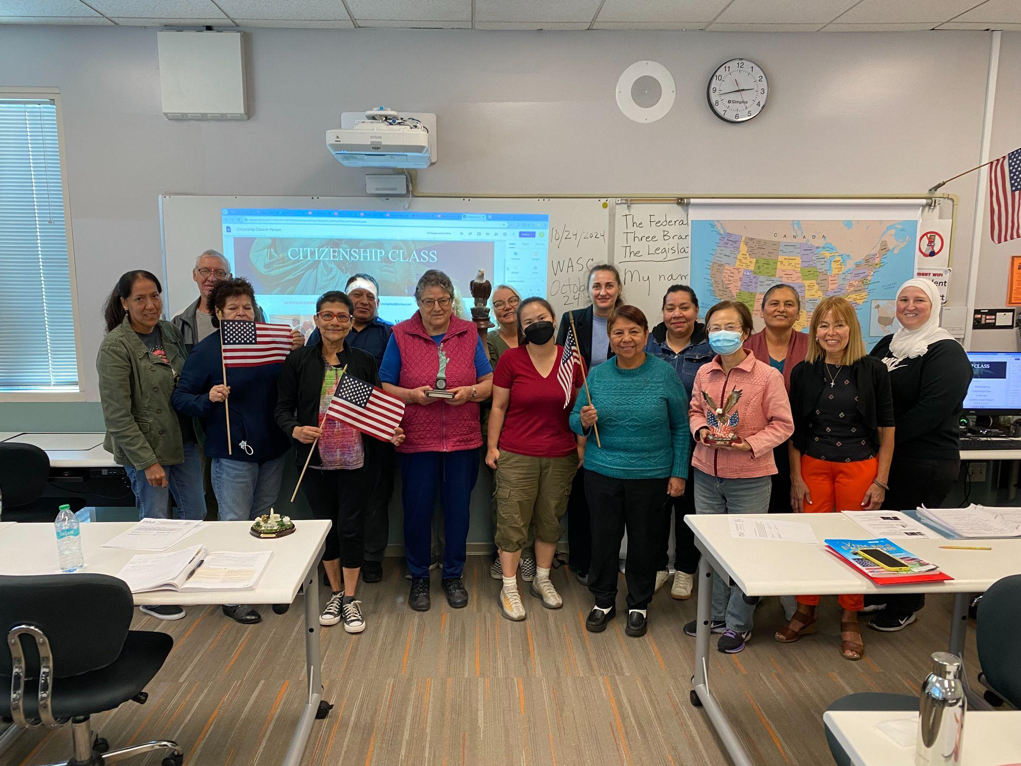
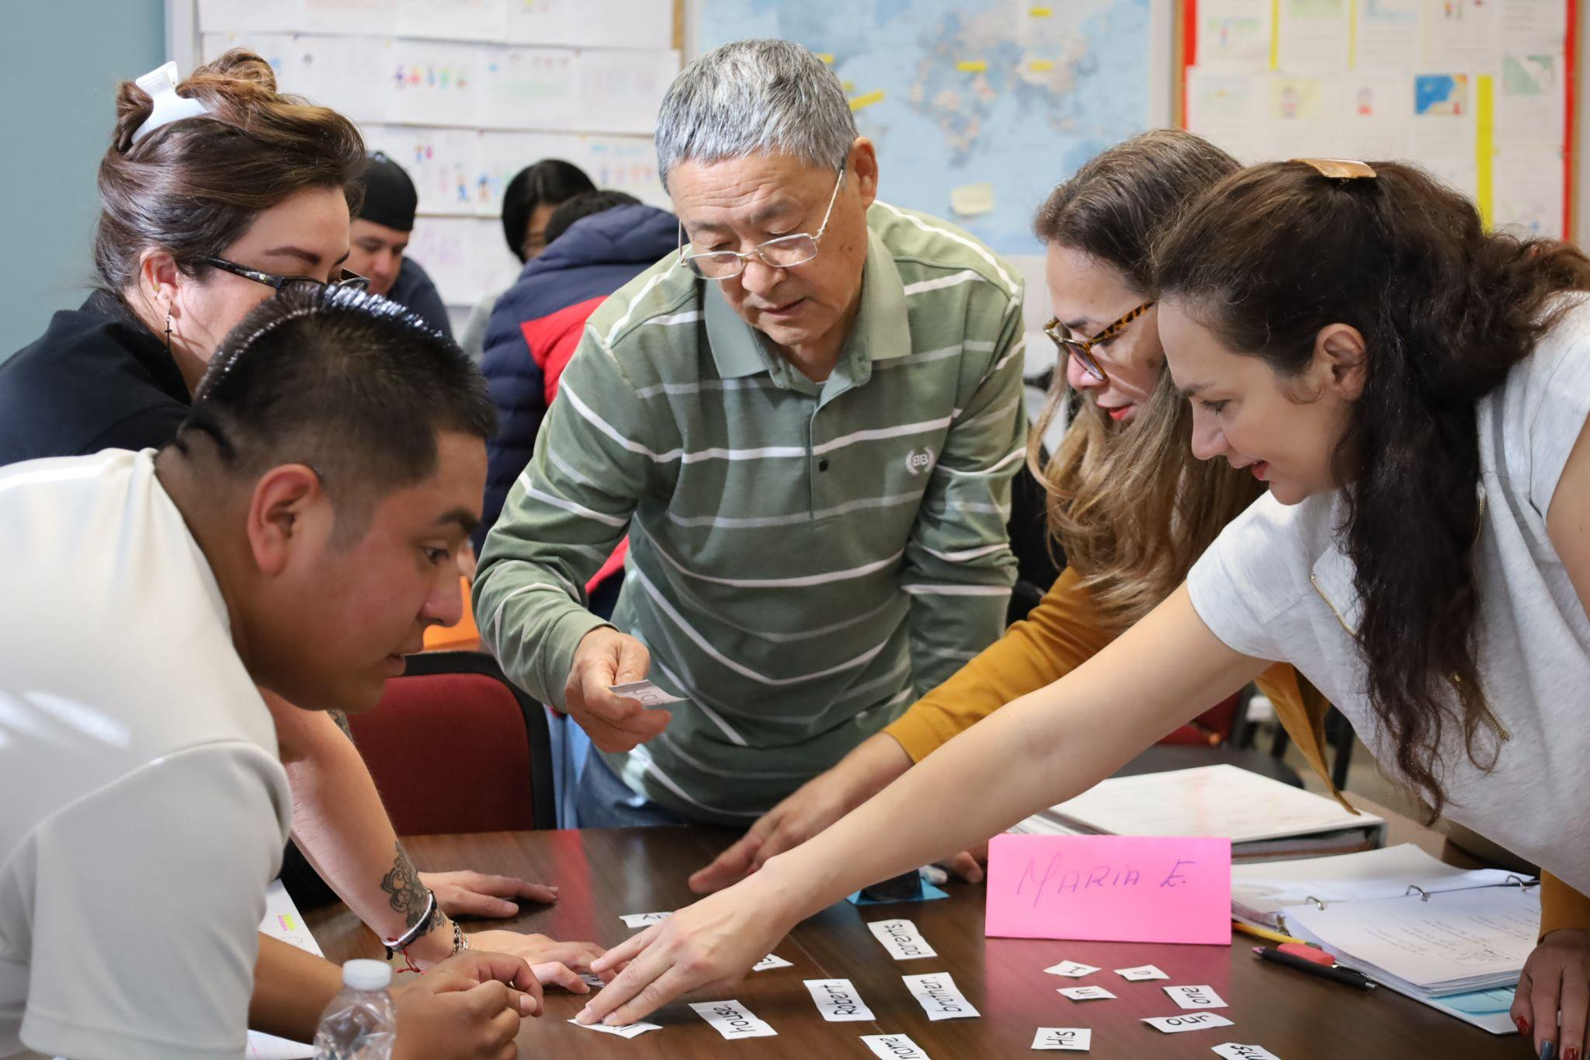
ESL/Citizenship in Action
Intermediate High ESL students practice with flashcards to learn about traffic signs for EL Civics.
ESL students at the Senior Center learn about singular and plural nouns.
Students prepare for the
U.S. Citizenship interview
Beginning Literacy ESL students work together to create sentences.
Notes:
Sarah & Jessica

Slide 9
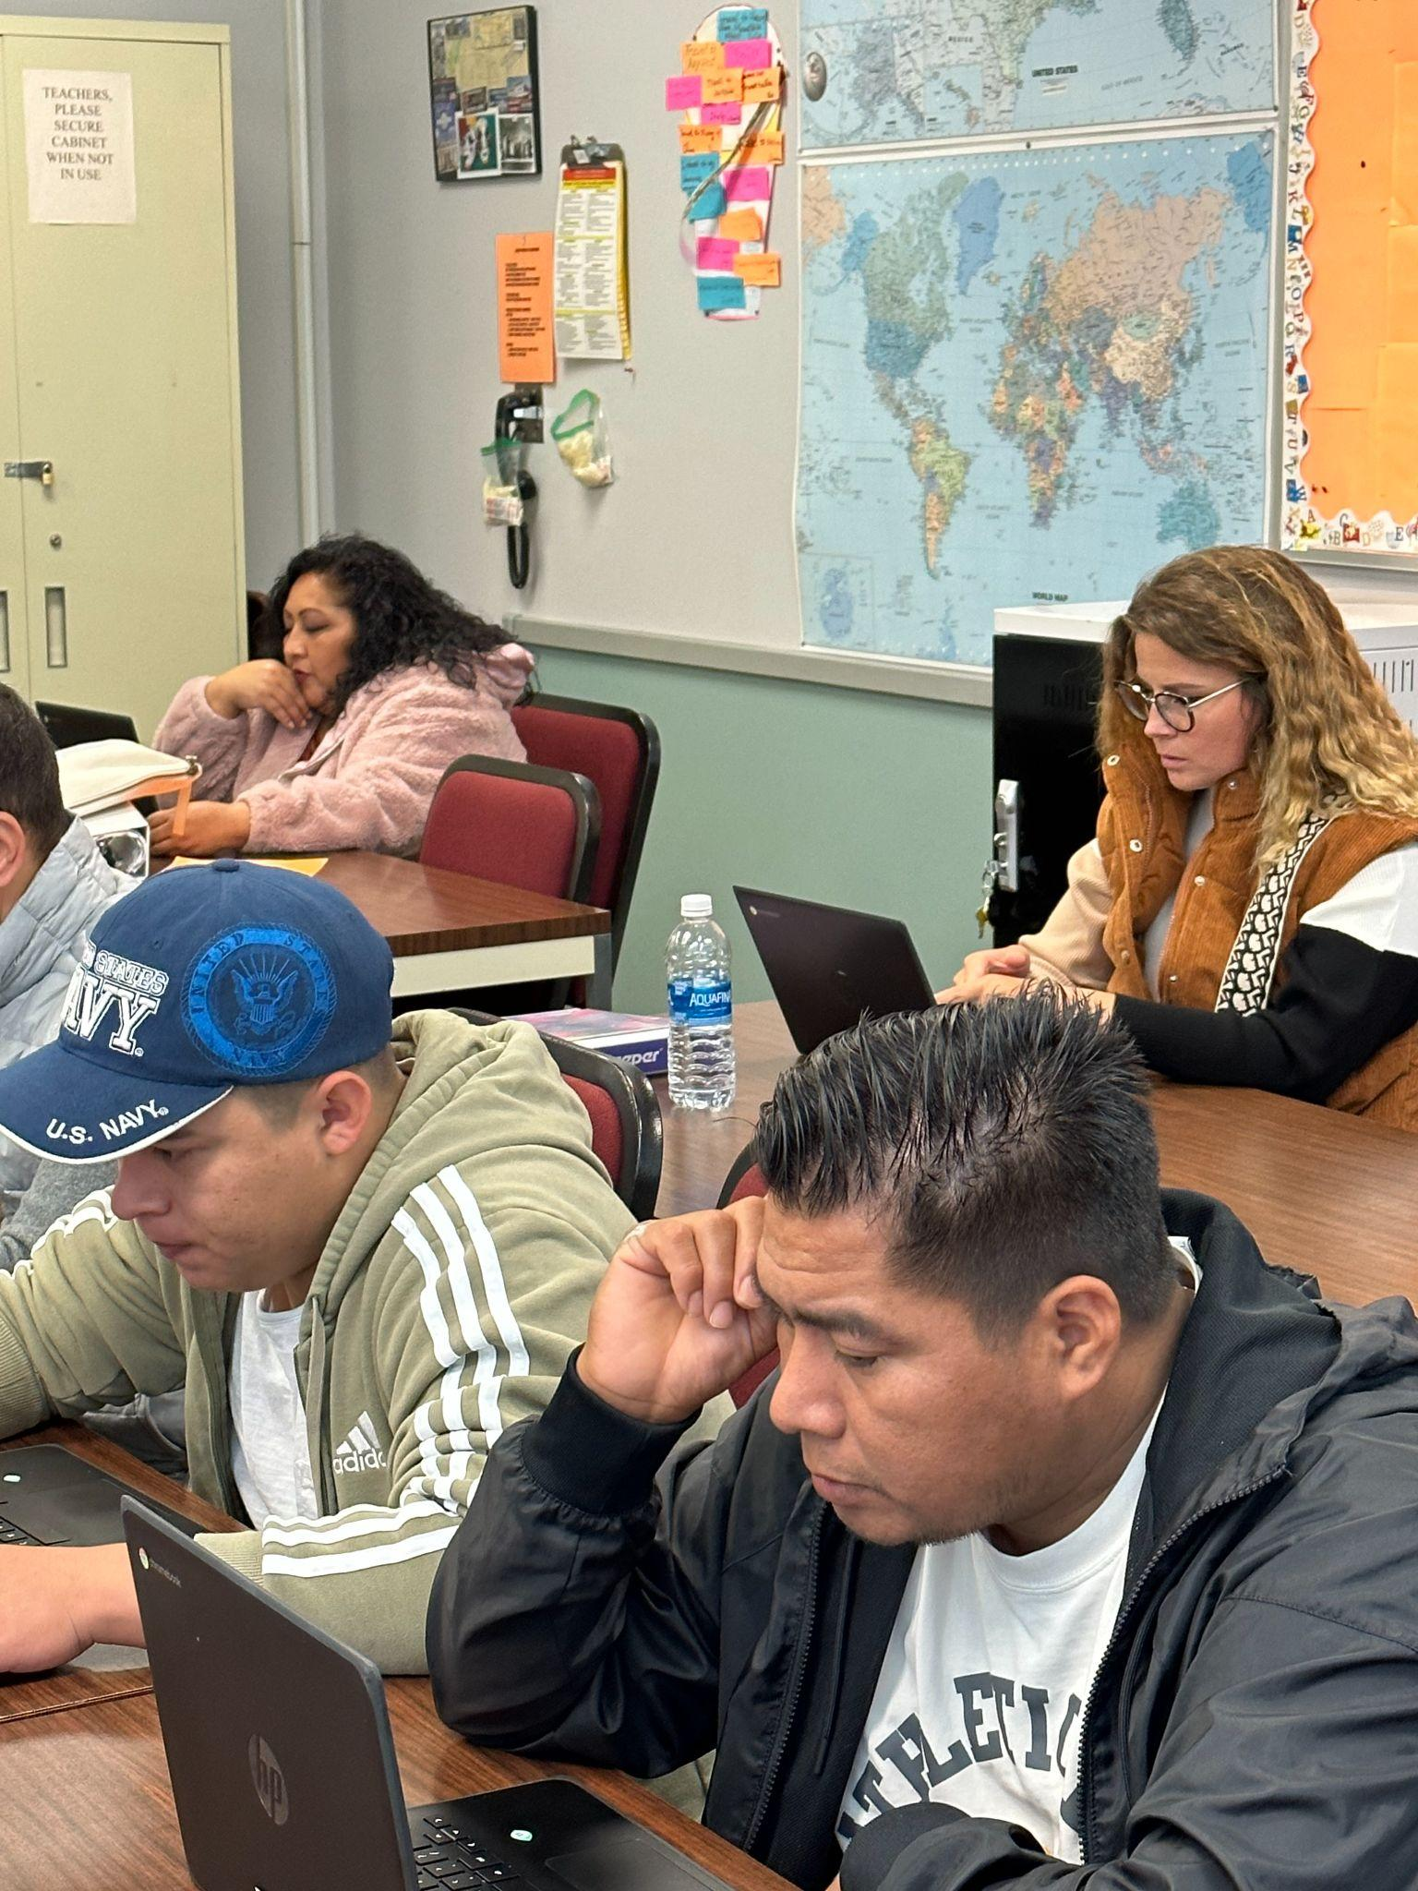
English as a Second Language (ESL)/
Citizenship Highlights (2023-2024)
Increased level completions – Fourteen percent (14%) increase in level completions as measured by the CASAS STEPS reading test.*
Student Placement – Placement process refined with additional interview and writing components improved initial student level placement accuracy.
Course Outlines – Updated course outlines for all 6 levels of ESL aligned with current NRS standards, English Language Proficiency Standards, and the California Immigrant Integration framework.
Instruction – Teachers learned to use new CASAS STEPS test reports to inform instruction.
*Refer to page 5 of data report
Notes:
Sarah and Jessica

Slide 10
ESL WASC Goals and Progress
WASC Goals #1-2 | Progress (23-24)
Identify and use assessment results to make improvements to classes and programs Understand and incorporate new, standards-aligned CASAS STEPS series. Use post-test results from CASAS STEPS to inform instruction. | Full program-wide adoption of online CASAS STEPS testing for placement of incoming students into six levels of ESL. Placement process has been refined to ensure that students begin instruction in a well chosen class. CASAS STEPS eTests implemented across all levels to monitor student learning gains (pre- and post-testing). Coordinators and teachers learning to interpret new test result reports to make instructional improvements.
2. Ensure course competencies reflect the latest standards and align student learning outcomes across all programs and classes Use English Language Proficiency Standards (ELPS) and leveled exit goals (writing, tech, academic vocabulary/reading) to update course outlines by June 2024. | Updated course outlines for all six core ESL levels and citizenship completed in May 2024. Course outlines reflect current NRS standards and ELPS as well as the immigrant integration framework. Teaching strategies listed on outlines were collected in departmental meetings.
Notes:
Sarah & Jessica

Slide 11
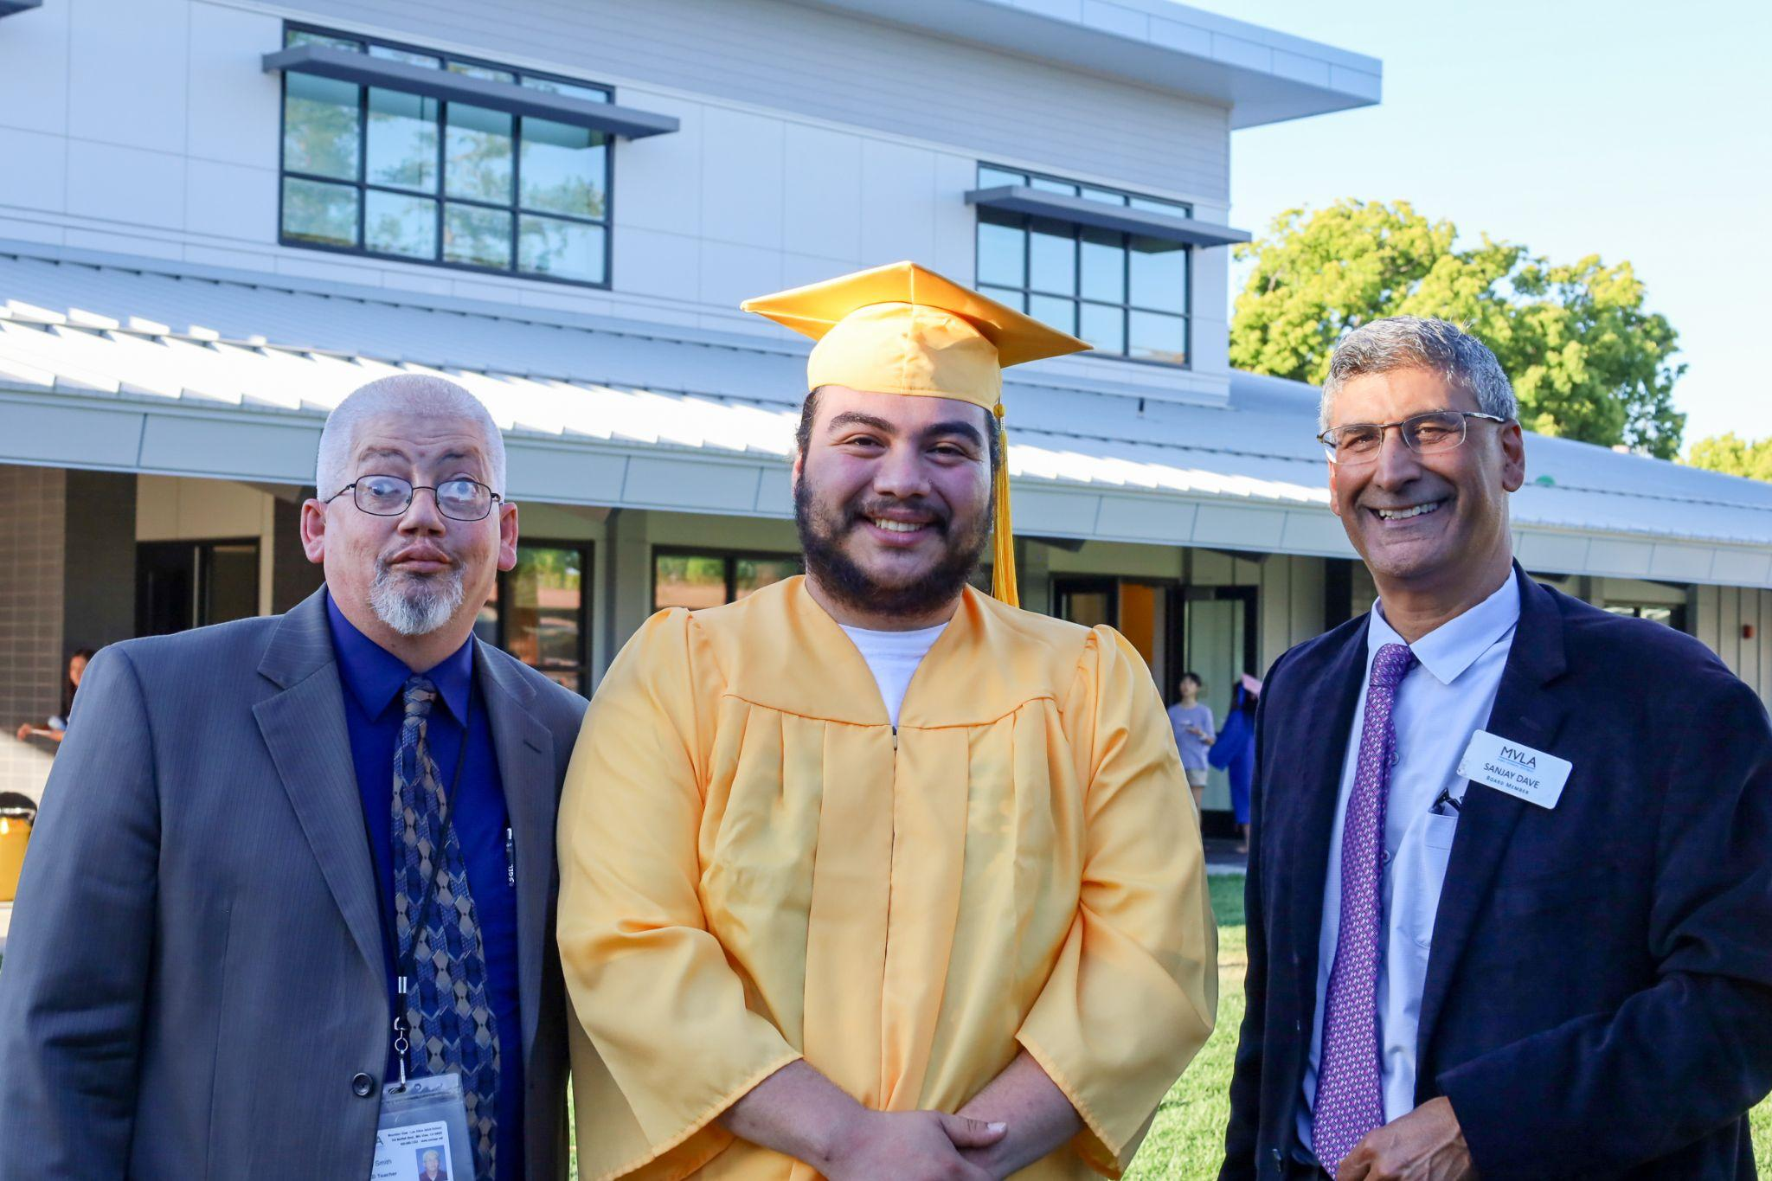
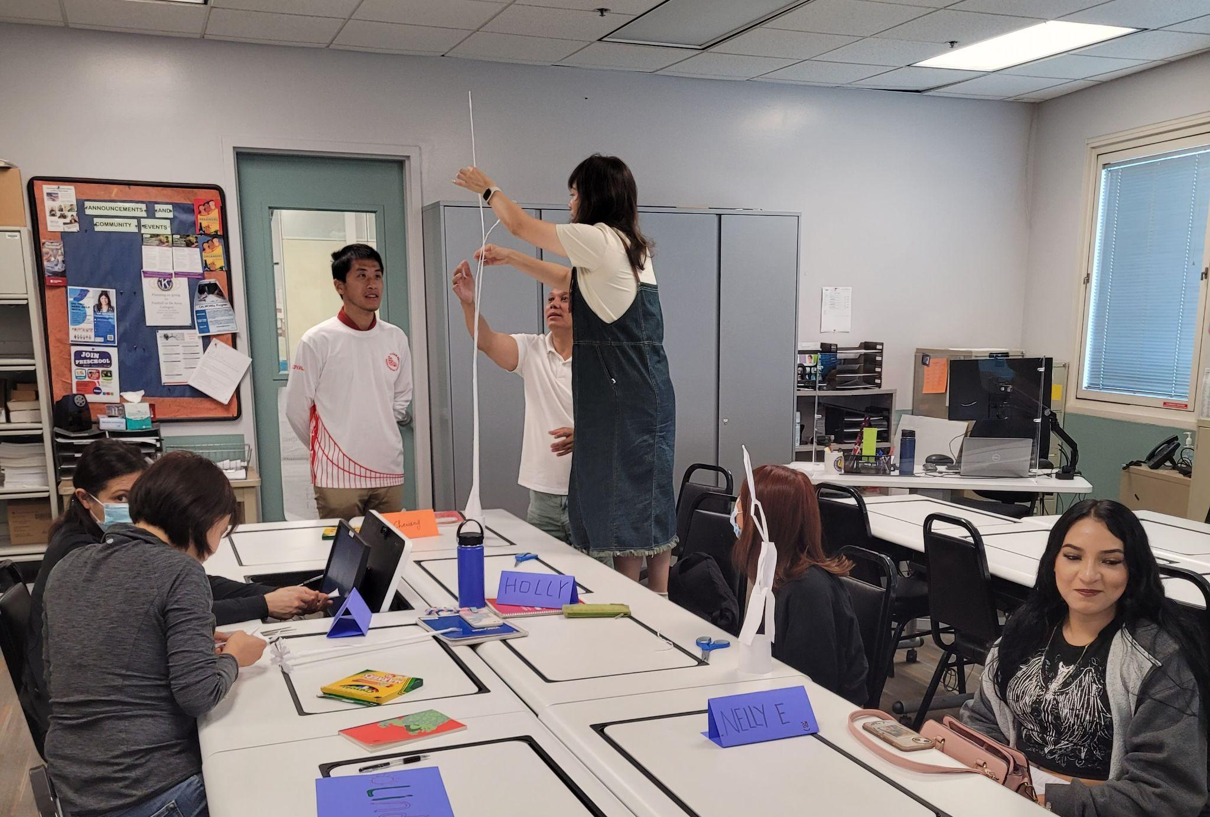
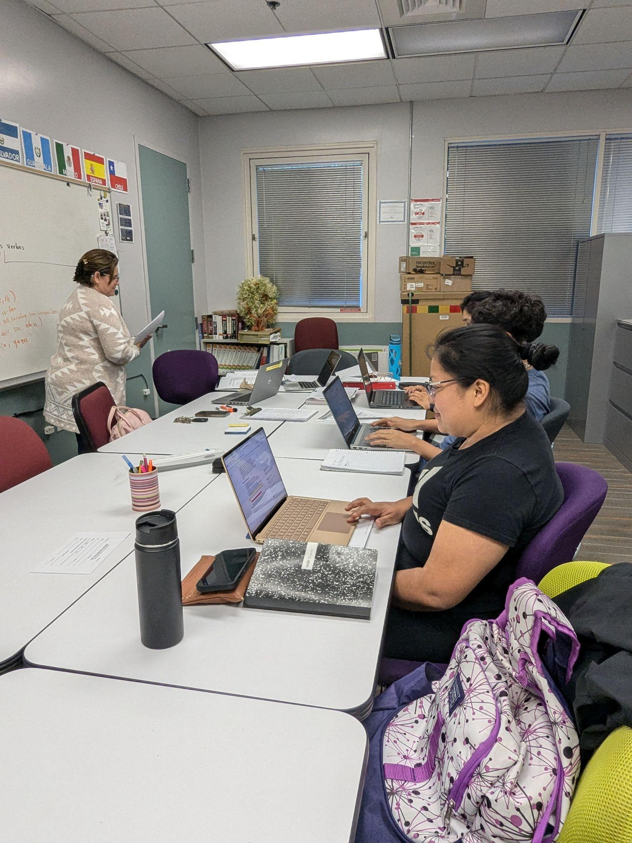
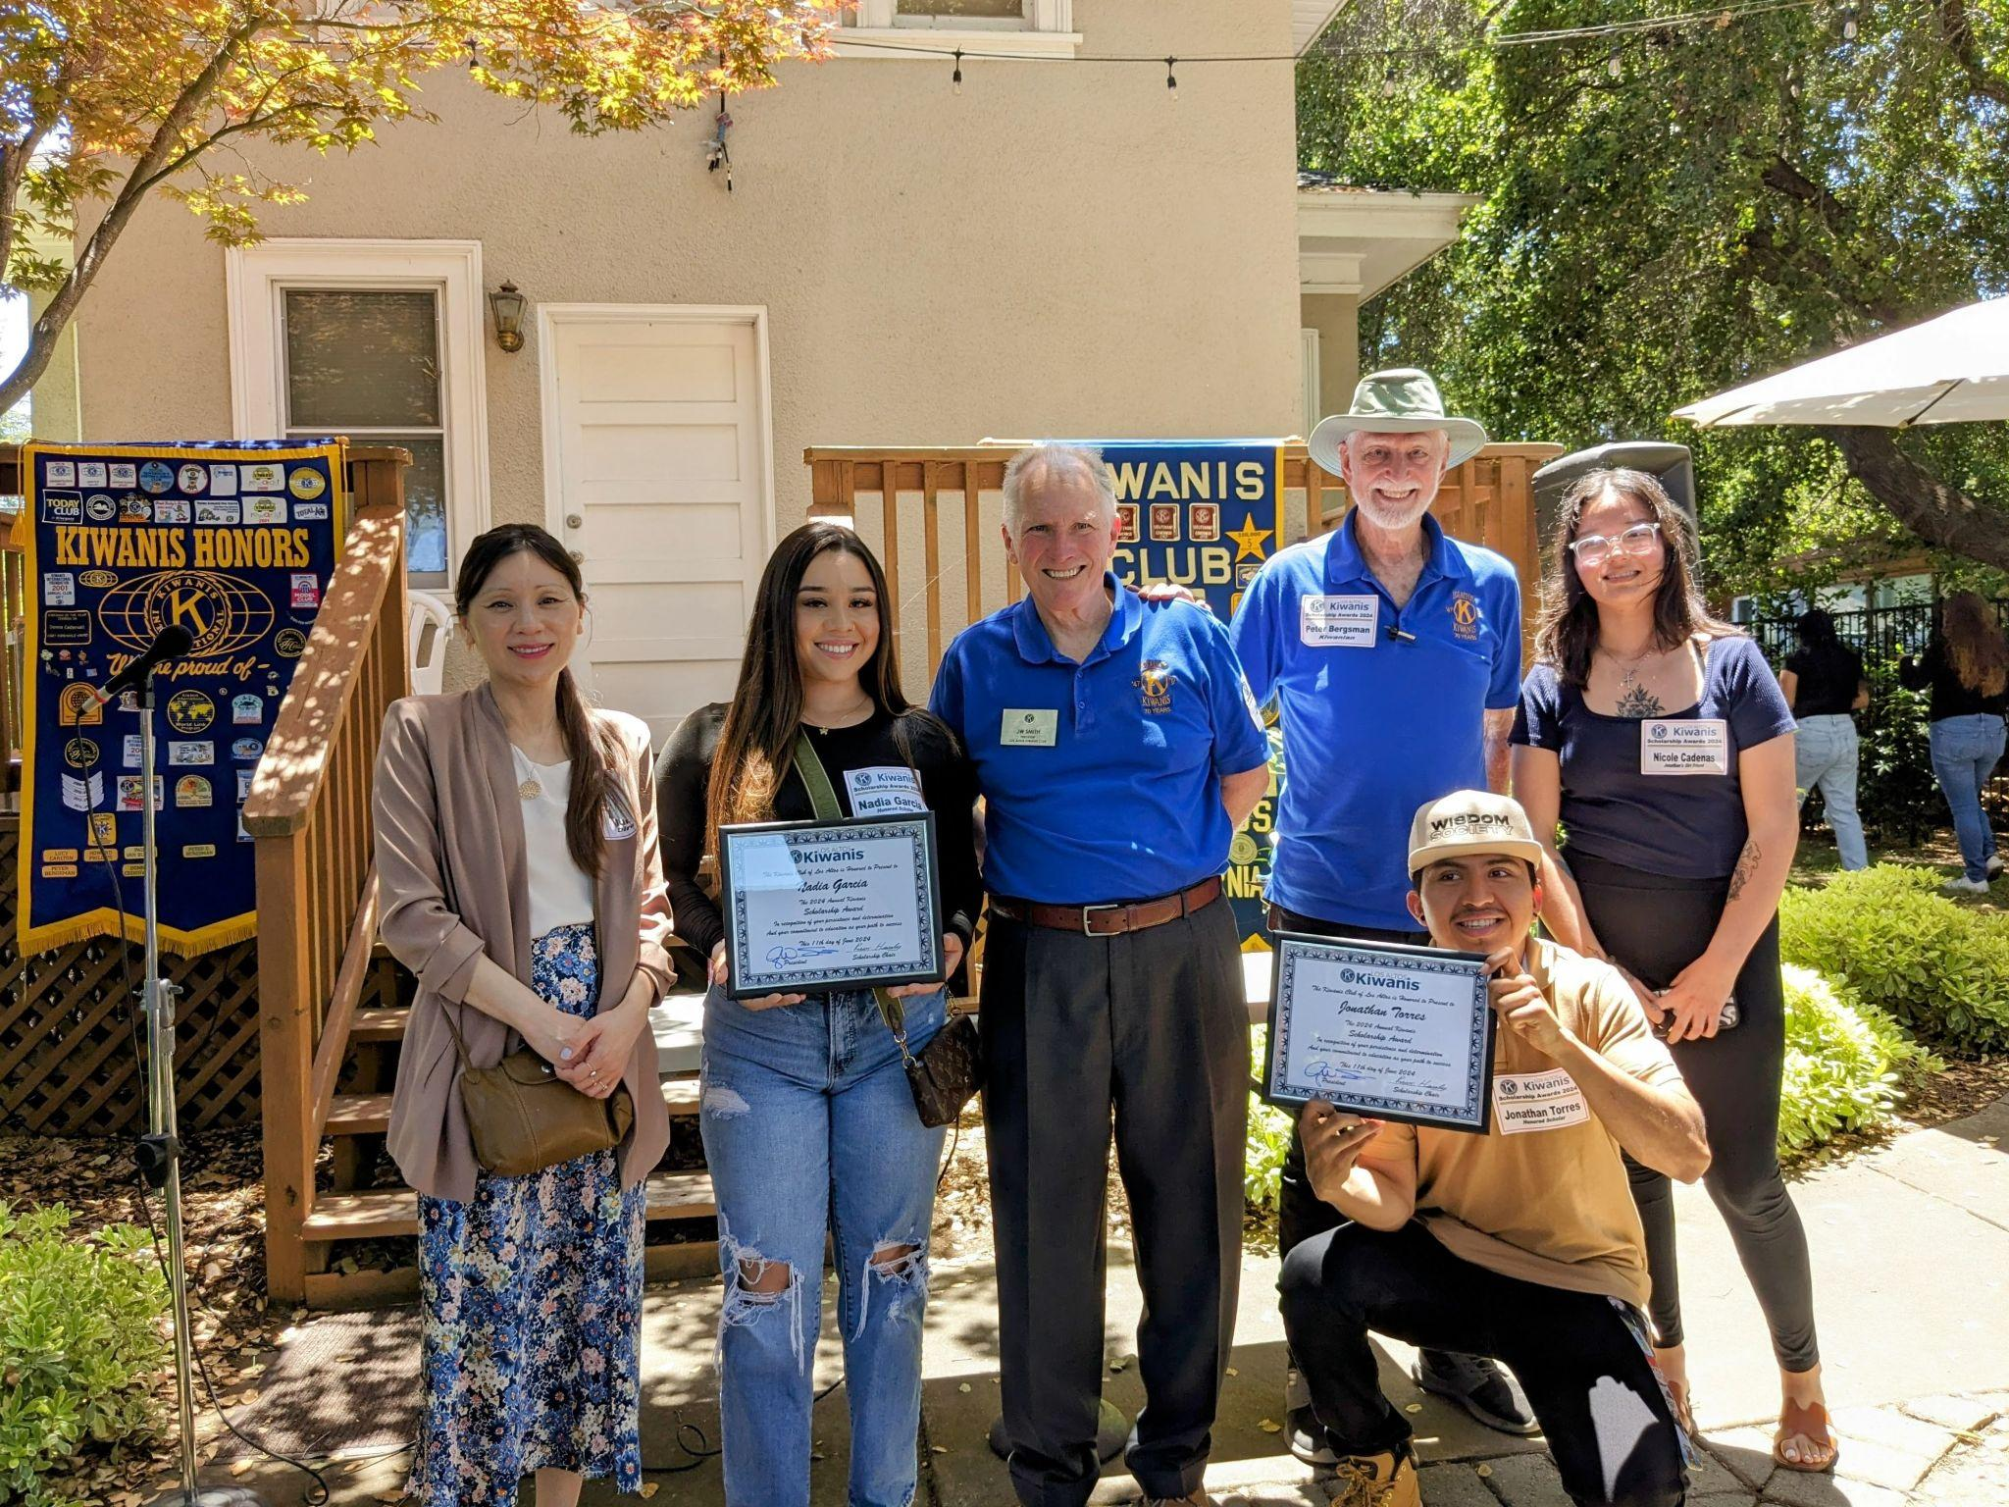
HSD/GED in Action
ASE graduation in June 2024
GED students collaborating to build the highest towers
Adult School students attending the LA Kiwanis Scholarship Luncheon
GED in Spanish students with Maestra Margarita
Notes:
Danielle

Slide 12
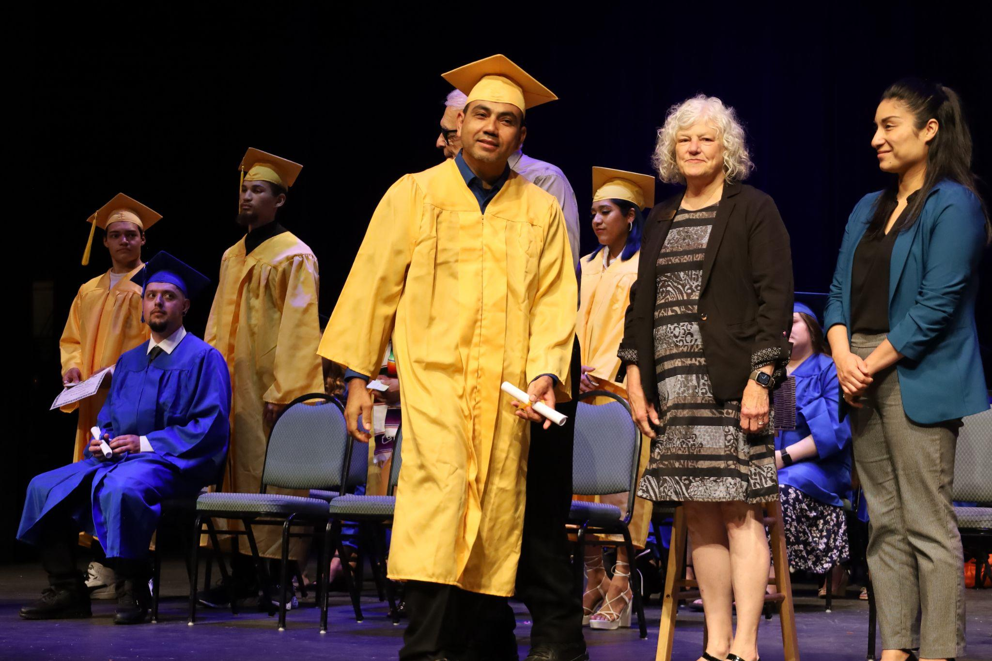
High School Diploma/GED
Highlights (2023-2024)
Student achievement - More adult learners are choosing to pursue a GED over a HSD, as evidenced in higher number of enrollment in GED program and higher number of GED completers than in 2022-23.*
Scholarships - The Los Altos Kiwanis Club and the Mountain View Rotary Club awarded two of our graduates with scholarships to continue their higher education at a local community college.
2024 Summer School - 82% of students who enrolled in online summer school successfully completed their course.**
*Refer to page 9 of data report
**Refer to page 10 of data report
Notes:
Danielle

Slide 13
ASE WASC Goals and Progress
WASC Goals #1-2 | Progress (23-24)
1. Identify and use assessment results to make improvements to classes and programs Improve preliminary assessments for placement into core instructional programs. Provide increased opportunities for teachers to review and analyze assessment results in order to improve student learning outcomes. | Used teacher observation and CASAS test results to inform placement level into PRE-GED or GED from ESL Used GED Ready and CASAS scores to promote students from Pre-GED to GED Allocated time on HSD/GED meeting agenda for teachers to share data and make adjustments to pacing
2. Ensure course competencies reflect the latest standards and align student learning outcomes across all programs and classes All course outlines need to be updated to reflect alignment with current standards in each core program. Update program specific outcomes and align student learning outcomes across all instructional levels and classes. | Updated all course information sheets to reflect the latest state standards on Edgenuity Identified and aligned Pre-GED and GED standards
Notes:
Danielle

Slide 14
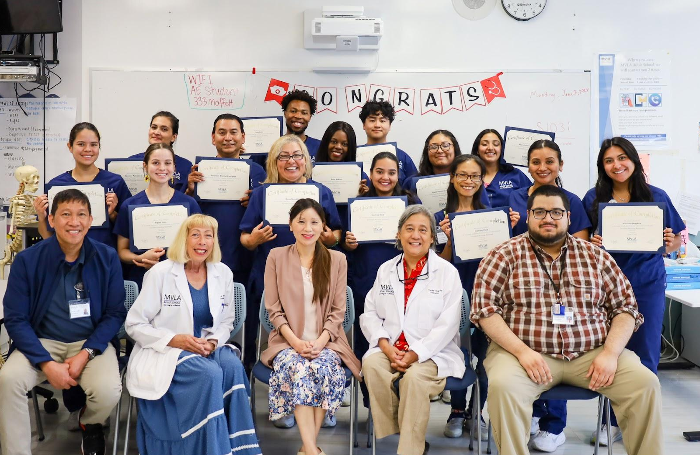
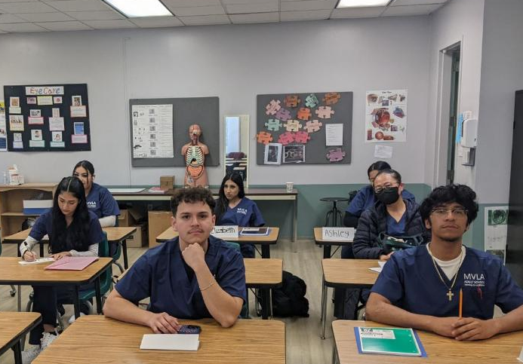
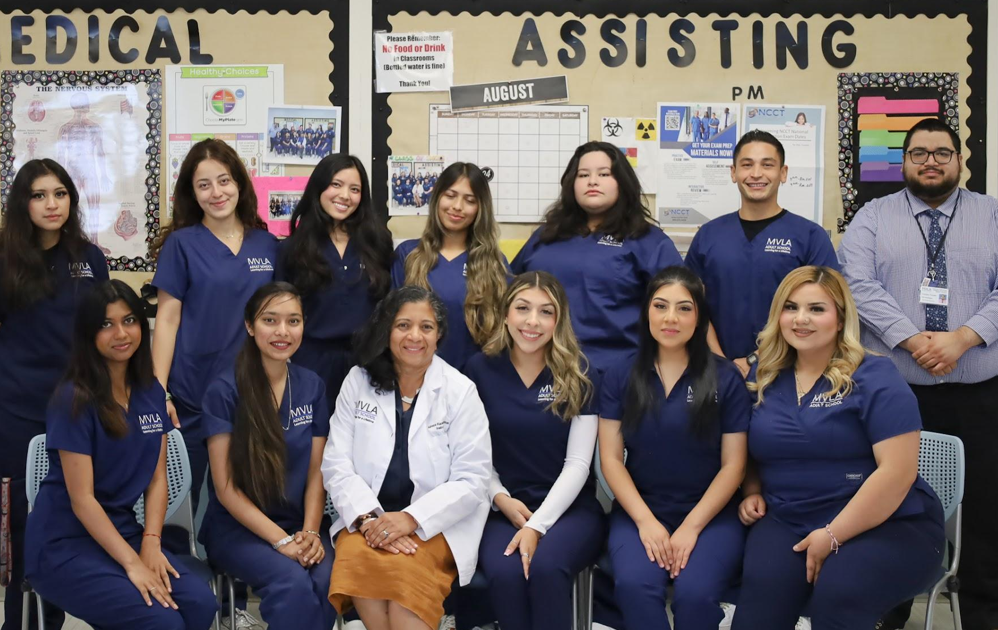
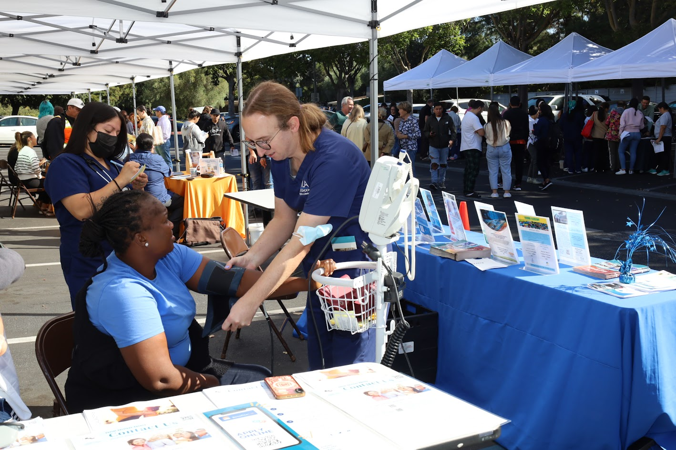
CTE in Action
Certified Nursing Assistant - Summer 2024 Cohort
Eye Care Technician March 2024 Cohort
Medical Assistant -
Spring-Summer 2024 Cohort
CNA Student Volunteers at 2024 Job Fair
Notes:
FP - The "CTE in Action" slide shows the hands-on experiences of MVLA Adult School students, including some of the largest groups since the pandemic. The CNA Summer 2024 and Medical Assistant Spring-Summer 2024 cohorts worked hard to complete their training and start healthcare careers. The Eye Care Technician March 2024 cohort focused on specialized skills, while CNA students at the 2024 Job Fair gained real-world experience by volunteering. These programs prepare students for success in their future careers.

Slide 15
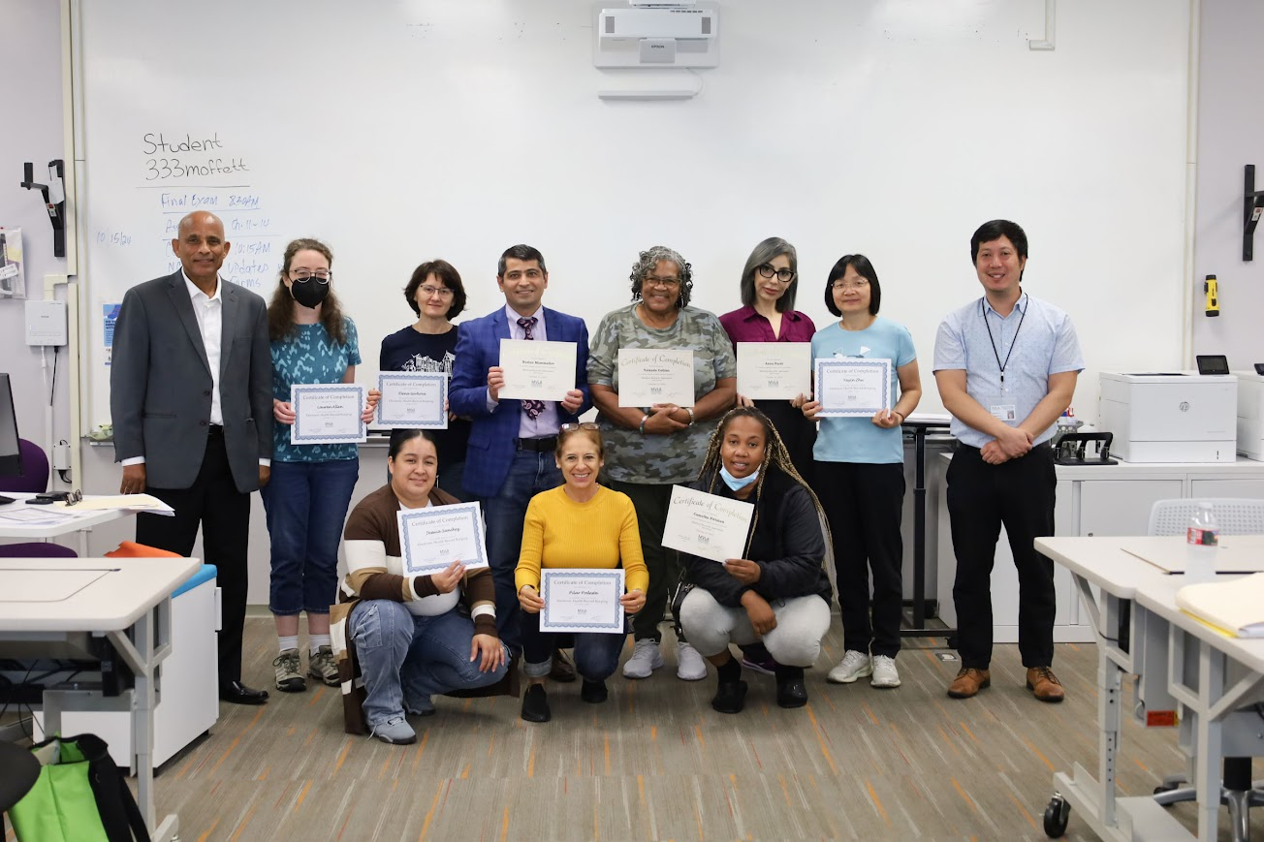
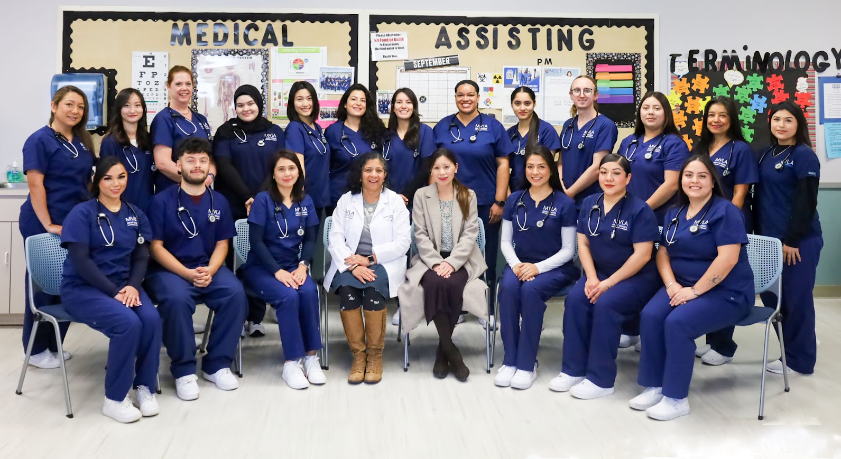
Career Technical Education (CTE) Highlights (2023-2024)
IET Medical Terminology for Advanced ESL Students
  IET Medical Terminology for Advanced ESL Students has proven to be a valuable program.
  Those who have completed MRS, MA, or CNA programs are earning an average of $27.84 per hour compared to the $19.20 per hour minimum wage in Mountain View, CA.
  The highest earner, an ESL student from Germany, is now making $50.00 per hour after being promoted from Medical Assistant (MA) to Surgical Technician.
Transitioning to Higher Levels in CTE Programs
  MVLA Adult School provides language support and training, enabling students to transition into tuition-free entry CTE programs. These efforts have led to increased success, higher completion rates, and better earning potential.
  Graduates often secure employment directly from externship sites. A notable example is a student who advanced from Medical Assistant to Surgical Technician, earning $50.00/hour, showcasing the program's impact.
Medical Records Specialist graduates, Admin and instructors showing pride in course completion
Medical Assistant graduates celebrating their success
Notes:
FP - The IET Medical Terminology program for Advanced ESL Students has proven invaluable, helping learners transition into healthcare careers with strong earning potential. Graduates of MRS, MA, or CNA programs earn an average of $27.84/hour, significantly above Mountain View's $19.20/hour minimum wage, with success stories like an ESL student advancing from Medical Assistant to Surgical Technician, earning $50/hour. MVLA Adult School also provides language support and training for students to enter tuition-free CTE programs, leading to higher success rates, completions, and increased earning potential, with many graduates securing employment directly through externships.

Slide 16
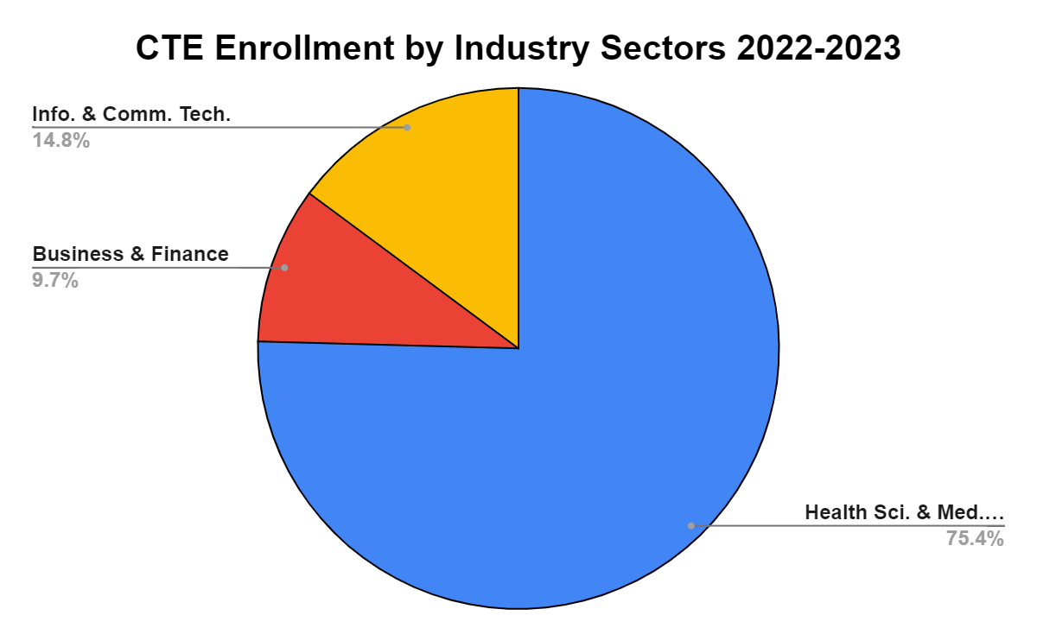
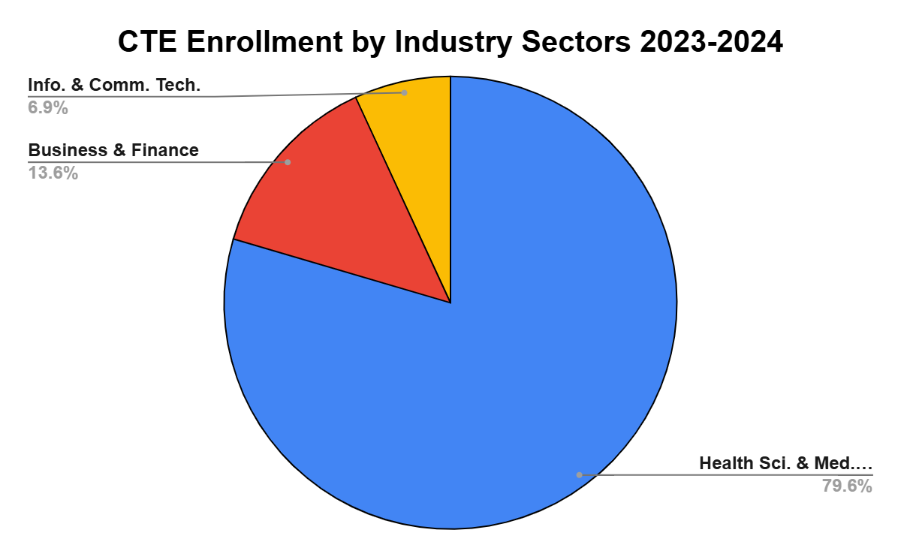
CTE Enrollment by Industry Sectors
There was a significant percentage increase in Health Science and Medical Technology classes and Business and Finance classes from the 2022-2023 school year to the 2023-2024 school year.
Notes:
Healthcare programs saw a significant increase in enrollment from 2022-2023 to 2023-2024, along with notable growth in Business and Finance classes. While IT enrollment showed a percentage decrease, total class hours have increased compared to last year, and efforts will focus on expanding IT programs and support in the coming years.

Slide 17
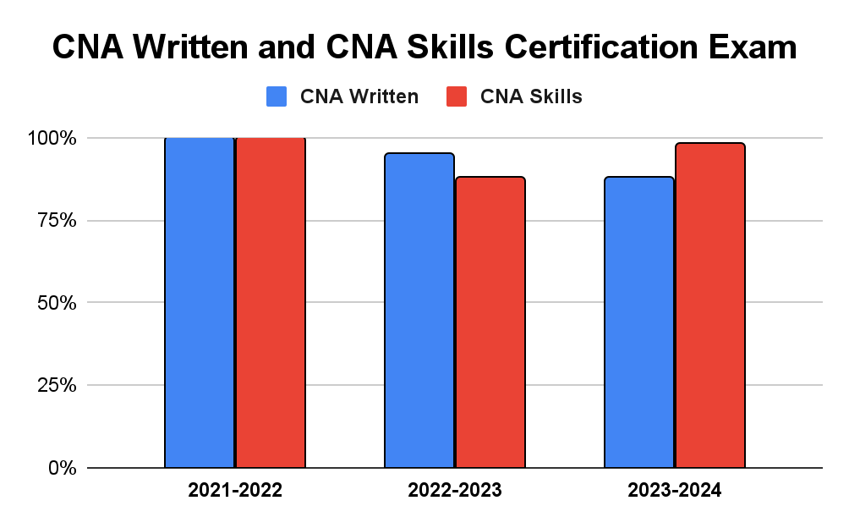
MVLA CNA Written and CNA Skills
Certification Exam Pass Rates
In 2023-2024, there was a 10% increase in pass rates of students taking skill tests and a 7% decrease in pass rates of students taking the written test of the Nationally Certified Nursing Assistant (CNA) examination.
Notes:
In 2023-2024, CNA skill test pass rates increased by 10%, reflecting the success of hands-on training, while written test pass rates decreased by 7% due to updates in state testing standards and new topics introduced. To address this, the curriculum has been updated to cover the new content, with additional study resources and focused tutoring implemented to better prepare students. These changes underscore MVLA Adult School’s commitment to aligning with state requirements and ensuring student success in all components of the CNA examination.

Slide 18
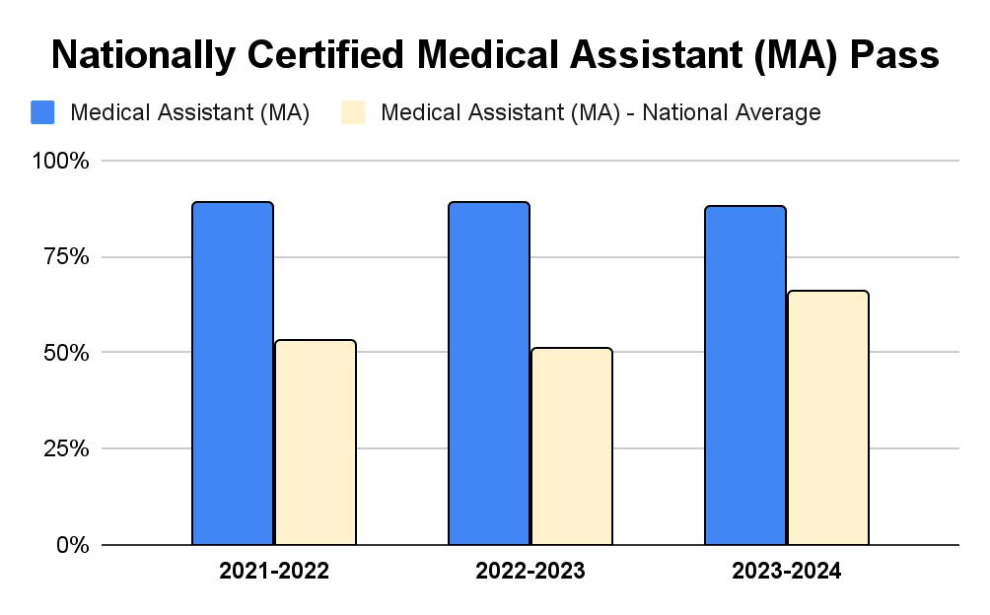
MVLA Medical Assistant (MA) Pass Rates
Compared to National Pass Rates
In 2023-2024, MA pass rates remained high in nationally certified examinations, far exceeding the national average.
Notes:
MVLA Medical Assistant (MA) students have consistently outperformed national averages in certification exams, maintaining high pass rates even with changes to national testing standards. This success reflects the program's adaptability, with ongoing efforts to align the curriculum and provide targeted preparation. MVLA remains committed to sustaining these results and striving toward a 100% pass rate in the future.

Slide 19
CTE WASC Goals and Progress
WASC Goals #1-2 | Progress (23-24)
1. Identify and use assessment results to make improvements to classes and programs Use formative assessments to create tailored interventions, such as tutoring services for CNA and MA. | CNA: Work with teachers to utilize formative assessment results to identify students in need of tutoring MA: Applying formative assessments to quickly identify students in need of tutoring services. Med Term for Adv ESL (IET): Use individual career assessments to transition students to appropriate Healthcare program
2. Ensure course competencies reflect the latest standards and align student learning outcomes across all programs and classes Update student learning outcomes to reflect the latest NCCT Medical Assistant competency standards. Align CNA Morning and CNA Evening course objectives with CDPH and Credentia National Certified Nursing Assistant standards. | MA: Currently implementing the revised curriculum standards, and will evaluate the effectiveness of the updated curriculum. CNA Morning and CNA Evening adopted the CNA FACETS supplemental skills curriculum that is align to CDPH standards. Full integration of FACETs into the CNA Morning program Google Classroom. Started the integration of the FACET’s curriculum for CNA Evening program.
Notes:
MVLA Adult School uses formative assessments to identify students needing extra support, offering tutoring in CNA and MA programs and guiding ESL students into appropriate healthcare pathways. The curriculum is continuously updated to meet the latest standards, with the MA program aligning with NCCT requirements and CNA courses meeting CDPH and Credentia standards. The FACETS supplemental curriculum has been fully integrated into CNA Morning classes and is being implemented in Evening classes, ensuring students are well-prepared for industry demands.

Slide 20
WASC Goals and Progress
WASC Goal #3: Increase student awareness and access to support services to promote equitable outcomes
SUPPORT SERVICES | Progress (23-24)
Academic Support ESL Small Group Tutoring (volunteers) ESL Conversation Club (volunteers) ESL Peer Tutor GED AM/PM Math Tutors (volunteers) GED (ESL/Math) 1:1 Pull-out Tutoring with Co-instructors CTE Embedded Tutors (Med Term for Adv ESL, CNA, MA) | Transition Advisor collaborated with ESL and ASE Coordinators to identify academic learning needs in programs. Transition Advisor recruited volunteer tutors to meet the needs. Teachers referred students to tutoring CTE Coordinator & Teachers identified students in need of tutoring & implemented embedded tutoring support in classes & 1:1 tutoring before and after class Added afternoon ESL conversation groups based on student interest
Technology Support for Students 1:1 Technology Advocate office hours Remind Workshops Zoom Workshops Basic Internet Skills Workshops Basic Computer Skills Workshops | Technology Advocates coordinated with ESL Coordinators to regularly promote workshops and office hours to students through class visits and flyers
Career and Transition Services Career Fair CTE Embedded Resume workshops (MA, CNA, MRS, MOA, ECT) CTE Externship Liaison Services (seamless transitions to employment) Career & Transition Workshop Series (open to all students) Employer Tablings Job Board College Field Trip College Information & Application Workshops Student Transition Plans (STP) | Transition Advisor coordinated with ESL, ASE, and CTE Coordinators to promote career and transition services and events through classroom visits and flyers Transition Advisor collaborated with CTE Coordinator and CTE Externship Liaison to support healthcare students beginning externships and employment through embedded resume workshops and career coaching Transition Advisor worked with regional college transition team to schedule and deliver college workshops to support students transitioning to college (CCC Apply, FAFSA)
Notes:
Jon

Slide 21
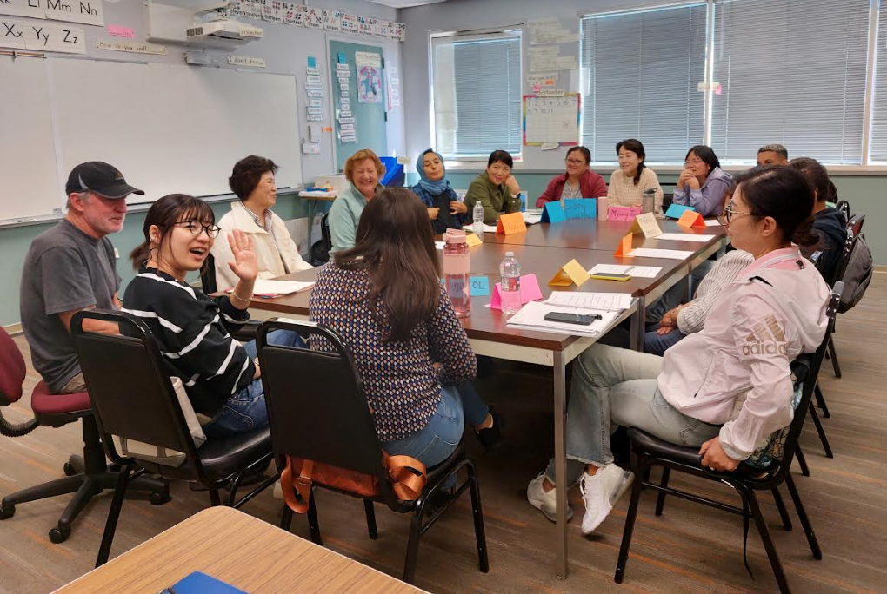
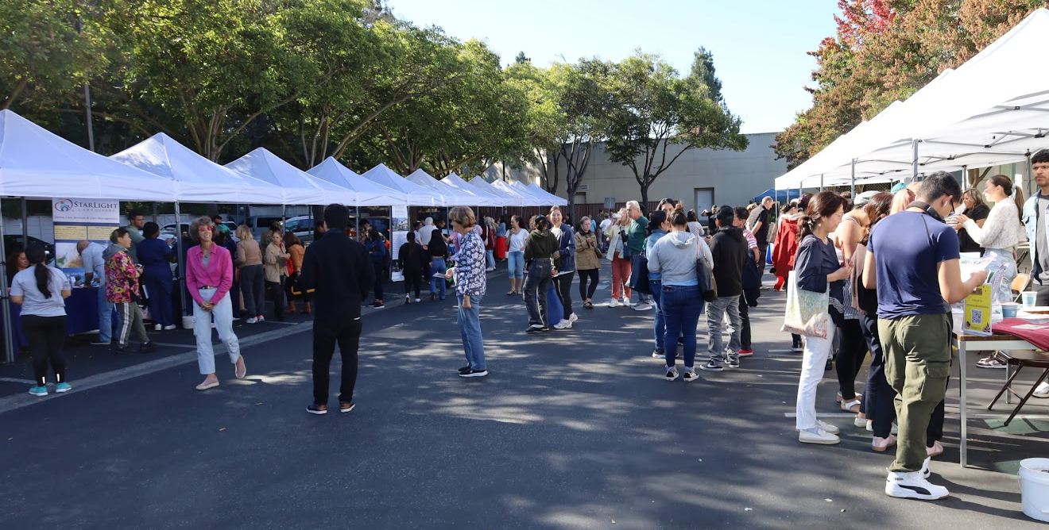
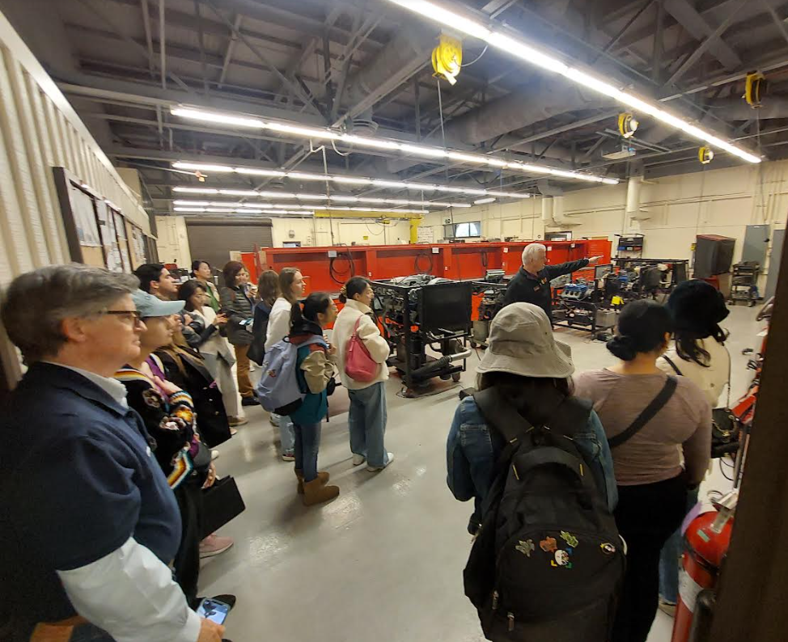
Transition & Career Services
Individual Appointments
Small Group Workshops
Community Events
Consortium Events
Annual Career Fair
Evening Employer Tabling
College Field Trip
Student Transition Plan
Support with College Registration
Targeted Career Workshops
Alumni Engagement
Notes:
Jon

Slide 22
Tutoring (2023-2024)
ESL Expanded ESL conversation groups to morning and afternoon based on student interest GED Recruited additional volunteer tutors to meet student tutoring needs CTE Implemented embedded tutoring support in classes & 1:1 tutoring before and after healthcare classes
STUDENT PARTICIPATION HOURS
ESL Writing Tutoring 284 Hours | GED Tutoring 150 Hours | ESL Conversation Club 324 Hours | College Info & Application Support 33 Sessions
Notes:
Jon

Slide 23
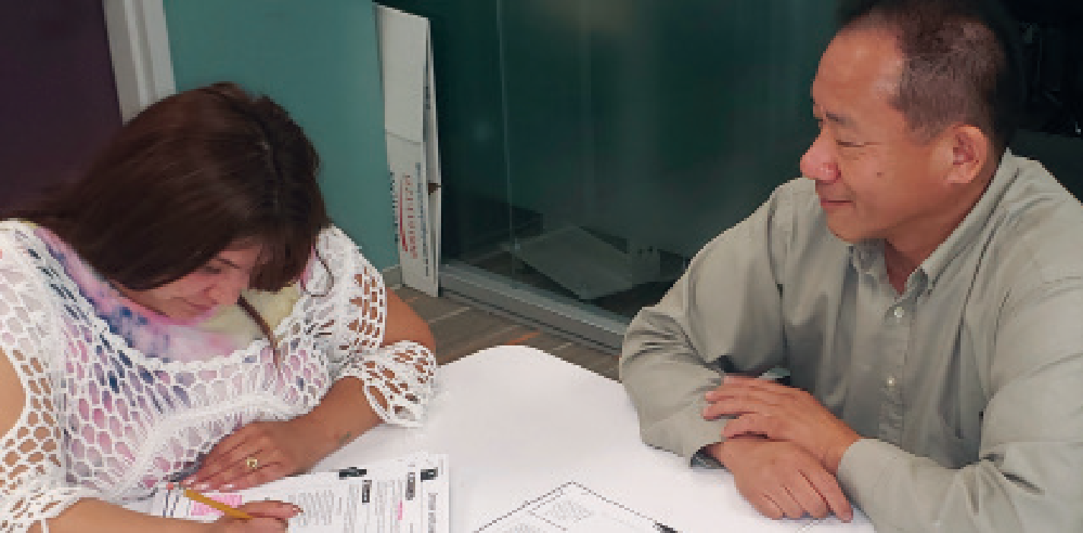
Technology Advocate Model
3 Tiers of Technology Support for Students
General Technical Resource Webpage
Small Group Technology Workshops
Targeted Technology Support Workshops for New Incoming ESL Students to Support Learning
Individual 1:1 Student Assistance via phone, Zoom & in person
Our 2024-2025 priorities are:
Provide technical support to students:
  Remind
  Classroom Apps
  Internet & Email
Notes:
Jon

Slide 24
Technology Advocates (2023-2024)
Office Hours
Topics: Classroom Software, Device and Software Training, General Digital Literacy
1:1 Sessions: 116
Students: 106
Total Hours: 33
Workshops
Topics: Remind Support, Computer Skills, Internet Skills, Zoom Essentials
Workshops: 29
Students: 292
Total Hours: 24
Notes:
Jon

Slide 25
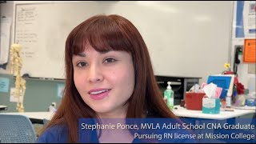
Student Success Stories
Notes:
Jon - https://www.youtube.com/watch?v=-u6lss3KCkY

Slide 26
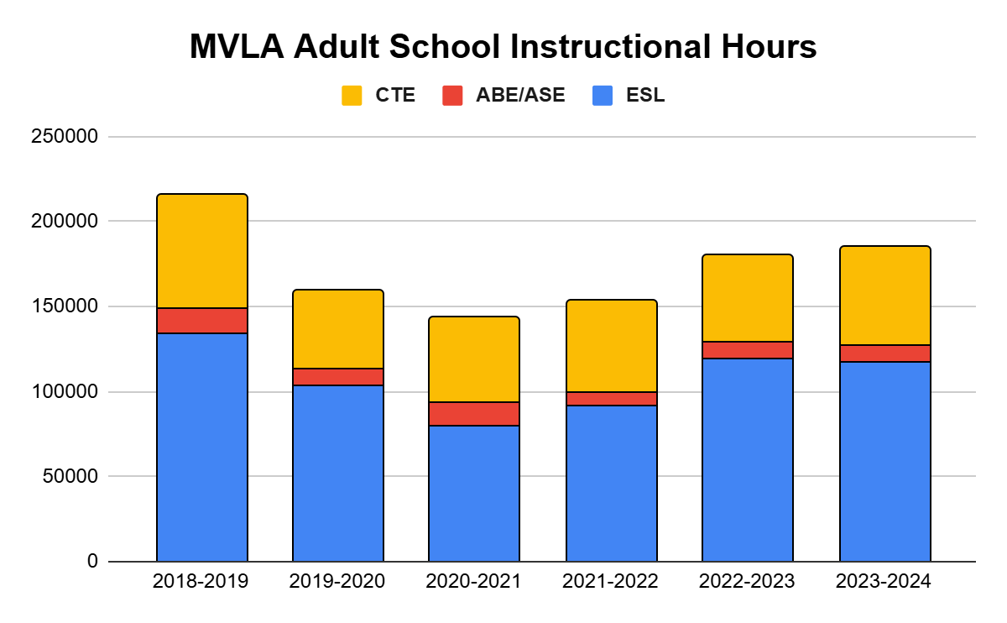
CAEP Accountability
Instructional Hours 2023-2024
The state holds each CAEP agency accountable by reporting the total number of instructional hours on an annual basis.
194,971
MVLA Adult School Total Instructional Hours for 2023-2024 increased by 4784 from prior year
Notes:
Jon

Slide 27


Fiscal Solvency
2023-2024
Consortium Dedicated Funding $10,466,894
(increase of $595,420 from previous year)
Total Member Allocation: MVLA Adult School (CAEP) $4,401,330 (42% of consortium)
Carryover of 4% from 2023-2024: $193,493
Additional AE Income:
$526,772 Grants (WIOA,CalWORKs)
$78,947 CTE Fees
AB 1491 - Adult Ed Consortia: Carryover of Allocated Funds (effective January 1, 2023)
Authorizes a consortium to reduce a member’s allocation based on the member having excessive carryover for at least 2 consecutive fiscal years beginning with the 2022–2023 fiscal year.
Notes:
Julie

Slide 28
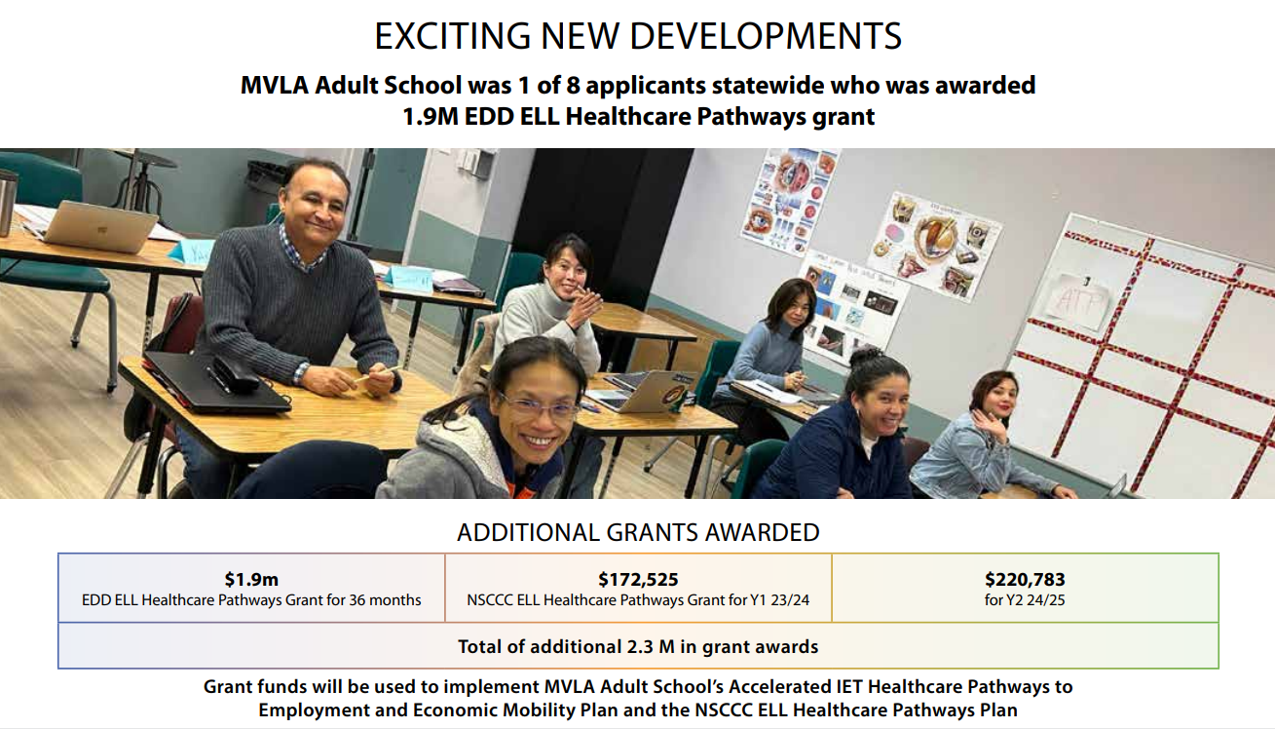
Notes:
Julie

Slide 29
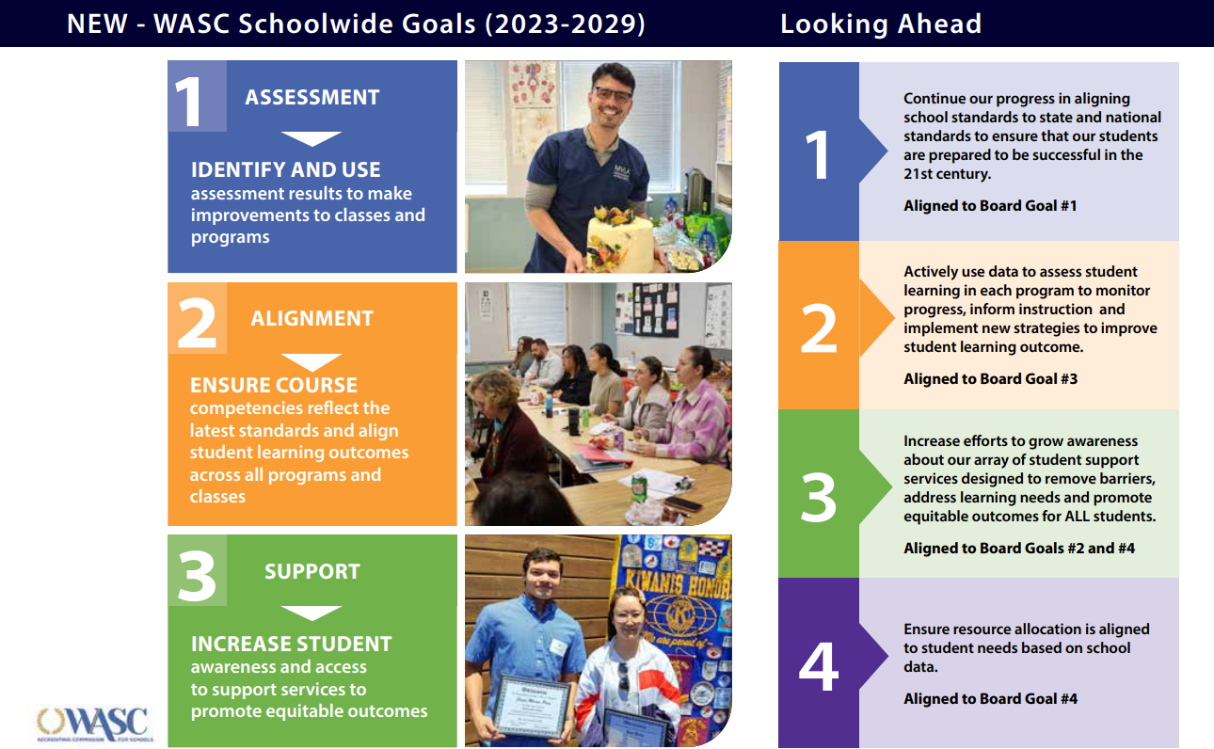
Notes:
Julie

Slide 30
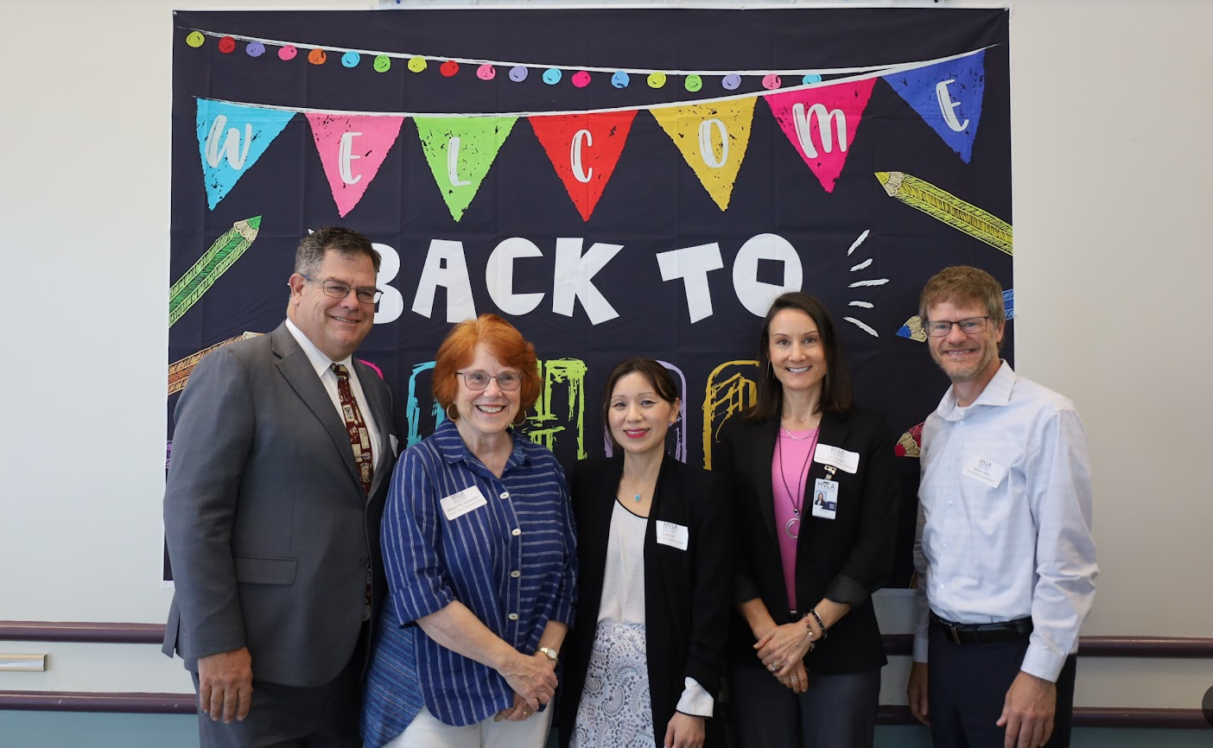
Acknowledgements
To our Superintendent, District Leadership and our Board of Trustees for making student achievement and equity the top priorities in our district.
To our adult school leadership team, teachers, and support staff for contributing to a school culture that values academic excellence, collaboration, equity, and service.
To our students who are at the heart of why we do what we do.
Notes:
Julie

Slide 31

THANK YOU
for your attention
Questions?
Notes:
Julie

