Slide 1




MEASURE E UPDATE:
Gym Modernization Projects
BOARD PRESENTATION
May 19th, 2025

Slide 2

PROCESS
MEETINGS & PRESENTATIONS
Design Committee: PE Staff, Boosters, Administrative & District Staff
WE ARE HERE
MOVE-IN FALL 2027
PROGRAM/SCOPE STUDY
SCHEMATIC DESIGN
DESIGN DEVELOPMENT & CONSTRUCTION DOCUMTNES
DSA REVIEW
CONSTRUCTION
DESIGN COMMITTEE MEETINGS UNDERWAY
COMPLETED FALL 2025
6 MONTHS
14 MONTHS*
SEQUENTIAL OR CONCURRENT CONSTRUCTION FOR EACH CAMPUS TBD*

Slide 3
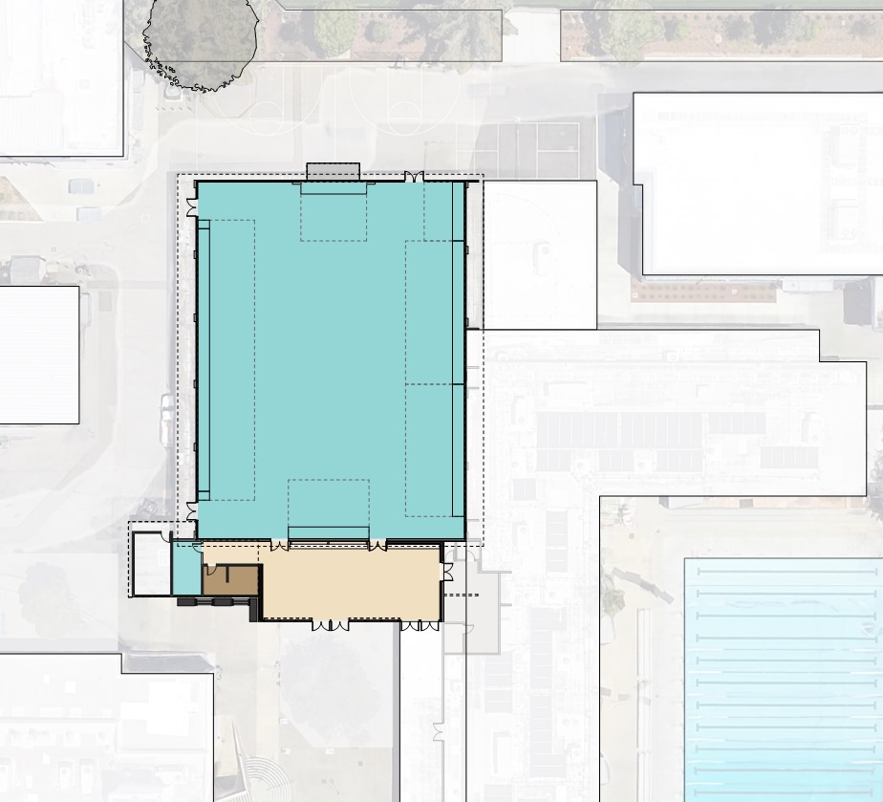
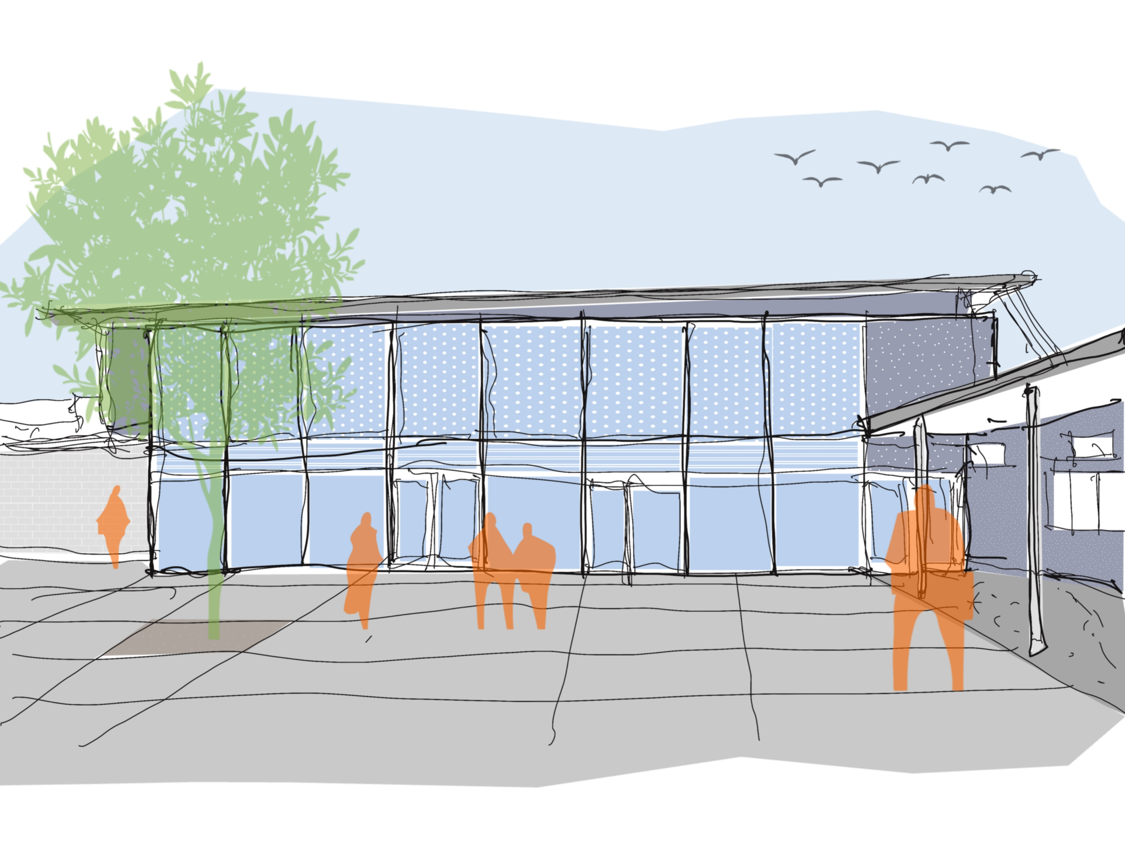
LOS ALTOS HIGH SCHOOL GYM
  Original Scope
  1 – Roof Replacement
  2 – HVAC Replacement
  3 – Bleacher Replacement & Additions*
  4 – Window Replacement
  5 – ADA Upgrades
  Additional Scope
  6 – Lobby Addition (1800 SF TOTAL)
  7 – AV and Lighting Upgrades
  8 – Acoustical Panels
  9 – BB Hoop & Equipment
  10 – Flooring and Other Upgrades
5
2
7
4
10
3
1
8
9
6
5
CANOPY ELEMENT

Slide 4
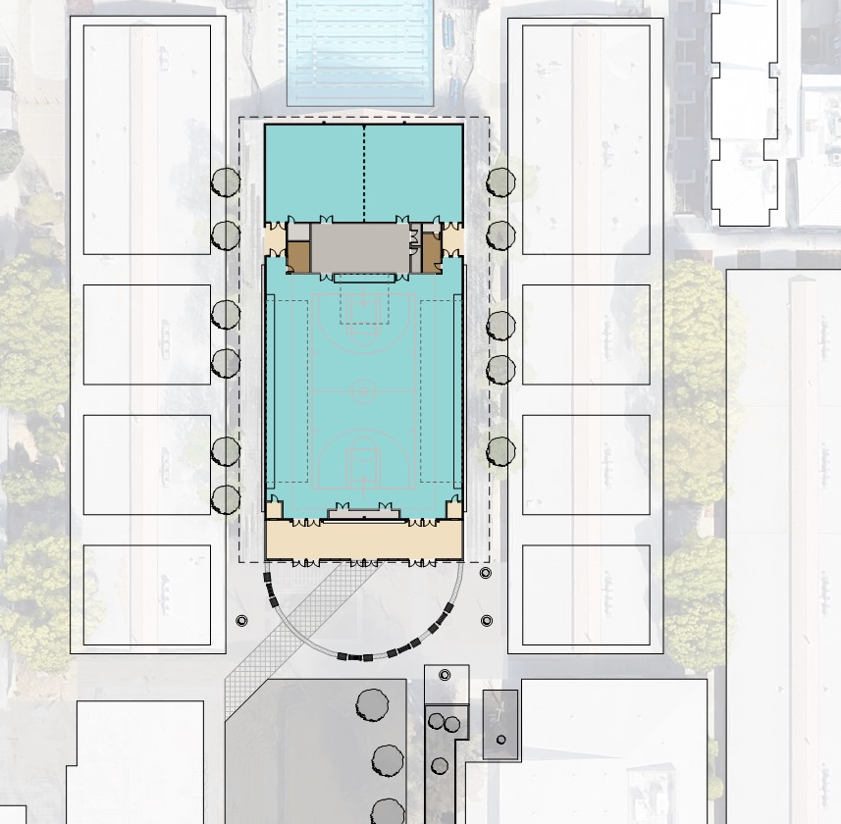
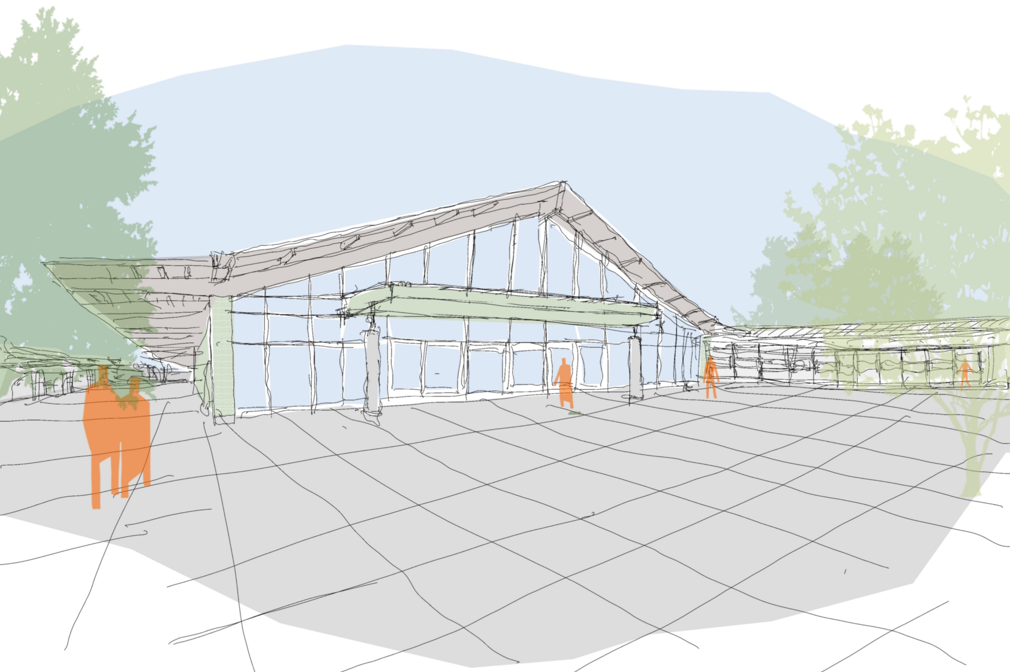
MOUNTAIN VIEW HIGH SCHOOL GYM
Original Scope
1 – Roof Replacement
2 – HVAC Replacement
3 – Flooring and Other Upgrades
4 – Repurpose Small Gym
5 – ADA Upgrades
Additional Scope
6 – Lobby Addition (1800 SF TOTAL)
7 – Landscaping and Sitework
8 – Window Replacement & Daylighting
9 – Bleacher Addition*
10 – Lighting Upgrades
11 – BB Hoop & Equipment
12 – Replace Finishes
13 – Enlarge Ticket Booths
14 – Exterior Paint
14
1
4
9
12
5
10
3
5
11
ADDITIONAL STORAGE
8
6
13
7
2

Slide 5
PROJECT BUDGET APPROVAL
Project Name |  | Estimated Budgets Presented at 1/27/25 Board Meeting
MVHS Gymnasium |  | $17.5M
LAHS Gymnasium |  | $13.5M
 | Total | $31M*
*Budget projections assume a concurrent construction start date of June 2026
Notes:
Note:
Under modernization, we cannot fit the school in this building
Alternative, look at new gyms, cost is significantly higher, and we would have equity issues

Slide 6
MEASURE E EXPENDITURE SUMMARY
Total Available Funds* |  | $43,820,000
Gym Projects |  | $31,000,000
Remaining Funds |  | $12,820,000
*Remaining Bond Funds: $7,912,000
*Total State Funds Received: $35,908,000
Estimated Potential State Fund Eligibility: $27M
Notes:
Note:

